Slide 1
APPLIED RESEARCH ON WHEAT AND ALFALFA MANAGEMENT
Dr. Romulo Lollato
Extension Wheat Specialist

Slide 3
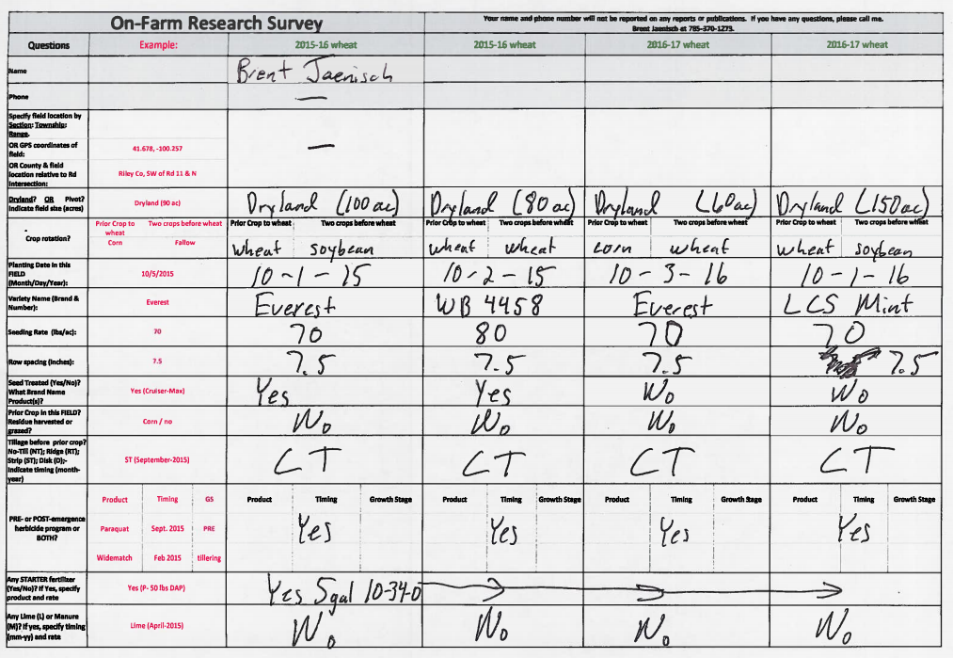

Slide 4
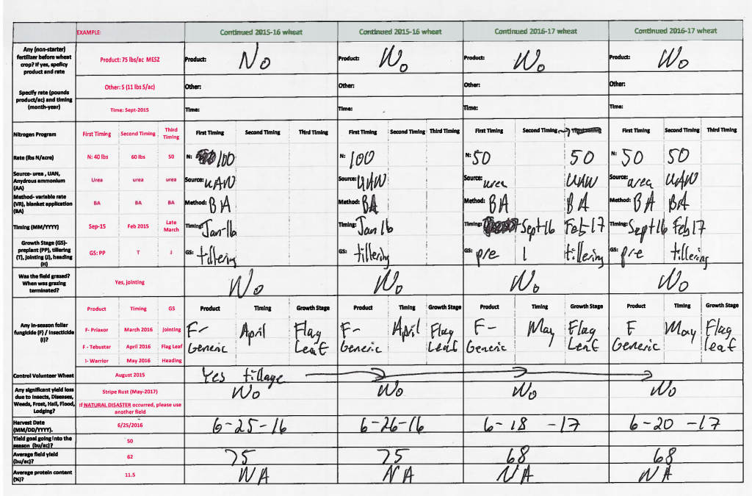

Slide 7
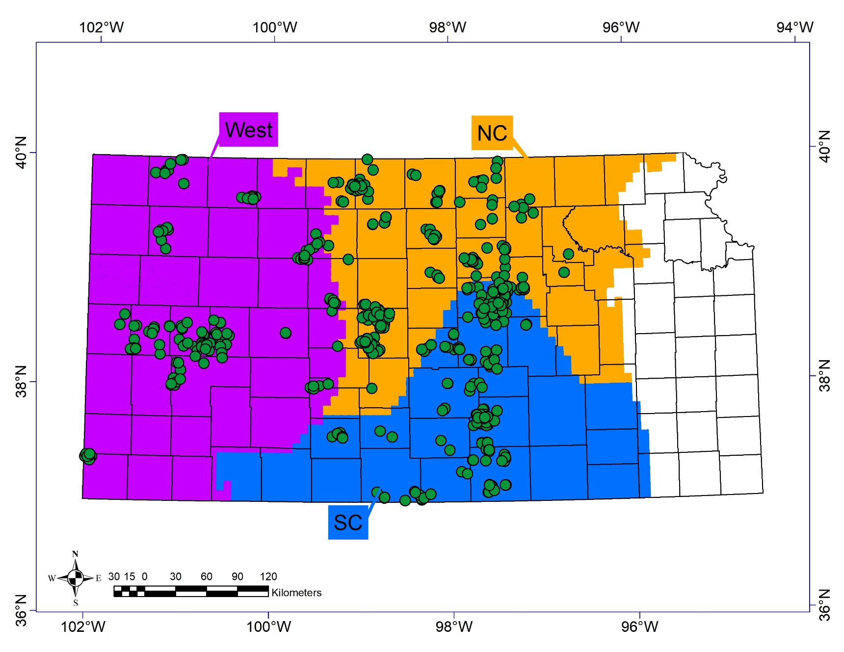
CLUSTERING OF FIELDS
Growing Seasons
2016, 2017, 2018
Regions
West (n = 150):
<635mm
3792-4829 GDD
North Central (n = 220):
635-890mm
3792-4829 GDD
South Central (n = 284):
635-890mm
4830-5949 GDD

Slide 8
RATE AND ADOPTION OF MANAGEMENT
RATE AND ADOPTION OF MANAGEMENT
Independent Variable |  |  |  | NC |  | SC |  | West
 |  | Units |  | Mean |  | Mean |  | Mean
Sow Date |  | Day of year |  | 282 |  | 287 |  | 275
Seed Rate |  | Kg ha⁻¹ |  | 93 |  | 90 |  | 68
Seed Fungicide |  | % |  | 81 |  | 71 |  | 29
Seed Insecticide |  | % |  | 55 |  | 62 |  | 28
No-Till |  | % |  | 75 |  | 52 |  | 48
In-Furrow Phosphorus |  | % |  | 70 |  | 65 |  | 62
Phosphorus Rate |  | Kg ha⁻¹ |  | 24 |  | 32 |  | 17
First N Rate |  | Kg ha⁻¹ |  | 72 |  | 72 |  | 58
Second N Rate |  | Kg ha-1 |  | 11 |  | 22 |  | 3
Total N Rate |  | Kg ha⁻¹ |  | 99 |  | 111 |  | 67
Sulfur |  | % |  | 52 |  | 45 |  | 28
Zinc |  | % |  | 43 |  | 14 |  | 38
Flag Leaf Fungicide |  | % |  | 55 |  | 56 |  | 42
Jointing Fungicide |  | % |  | 10 |  | 4 |  | 7
Prior Crop
Corn |  | % |  | 2 |  | 11 |  | 14
Fallow |  | % |  | 10 |  | 4 |  | 75
other |  | % |  | 1 |  | 4 |  | 5
Soybean |  | % |  | 44 |  | 30 |  | 1
Wheat |  | % |  | 42 |  | 51 |  | 4

Slide 10
-1.1 bu/a/day
-2.7 bu/a/day

Slide 12
-2.1 bu/a/day

Slide 13
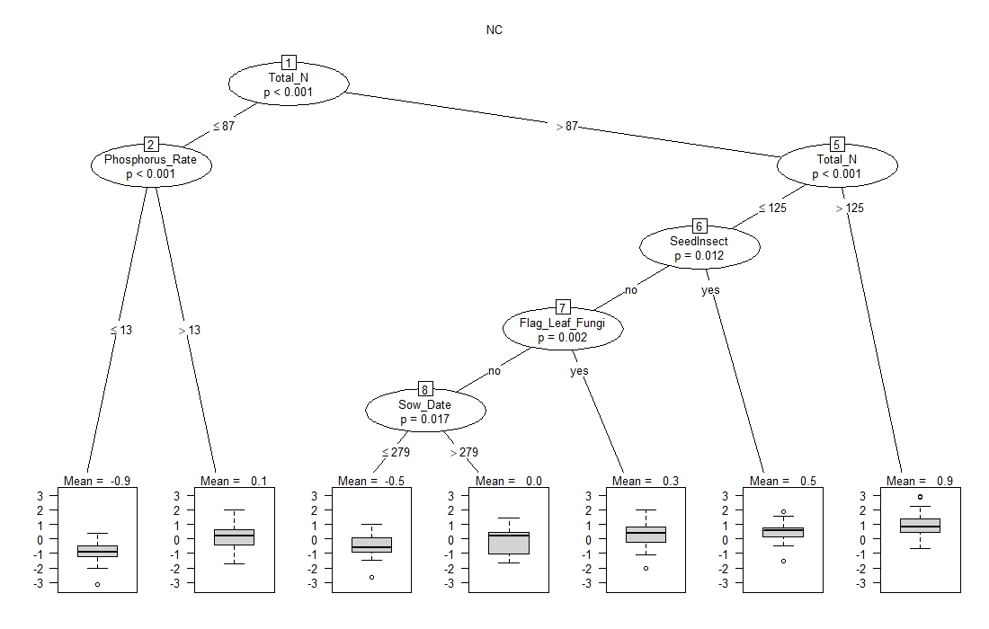
North Central

Slide 14
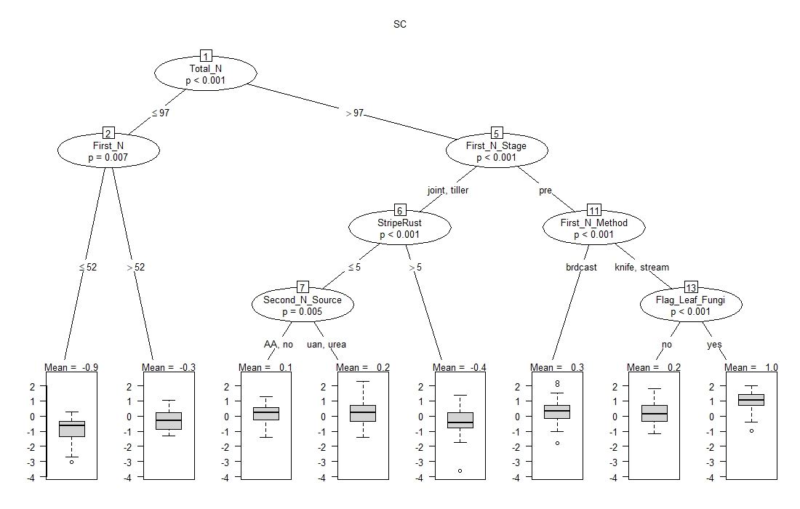
South Central

Slide 15
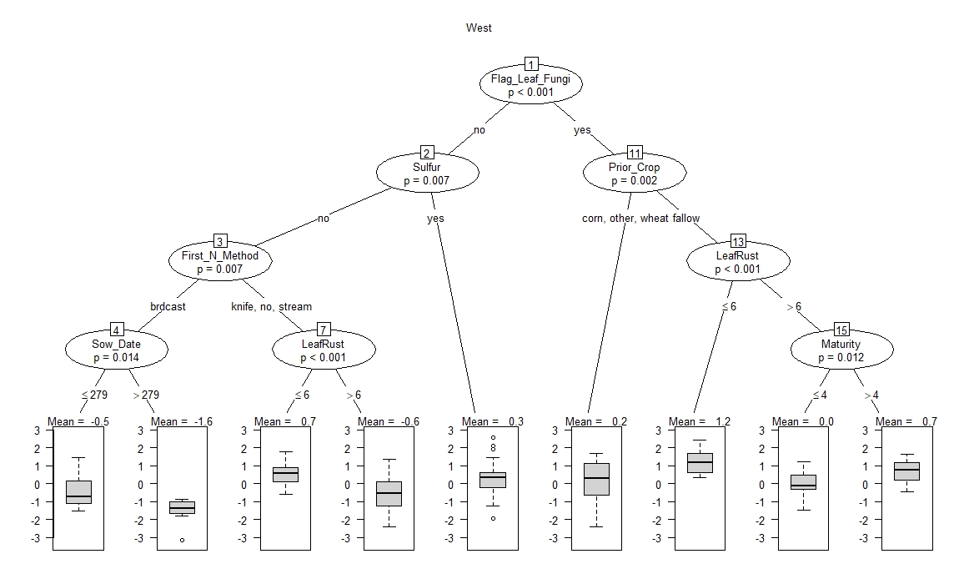
West

Slide 16
HIGH vs. LOW YIELDING FIELDS

Slide 17
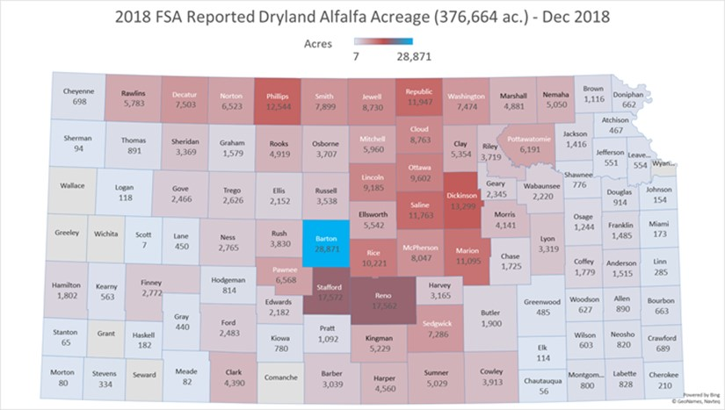
UPCOMING ALFALFA SURVEY
Fields per grower: 3-4
Seasons per field : 2016, 2017, 2018, 2019
Survey during: December 2019 – March 2020
Help identify growers
M.S. student: Kaylin Fink
Notes:
The presentation is divided in three parts, but with really one overarching objective:
To Educate farmers to grow to the yield they want…ENSURING the quality that you want
In my position in the university, I am in the frontline working with farmers
My program heavily sponsored by farmers to help them use new mgmt. tools to influence end-use quality
- Farmers believing and sponsoring so I can showcase the efforts we currently have in KS
- But ALSO, I want to learn from you WHAT QUALITY YOU WANT to deliver back to growers

Slide 18
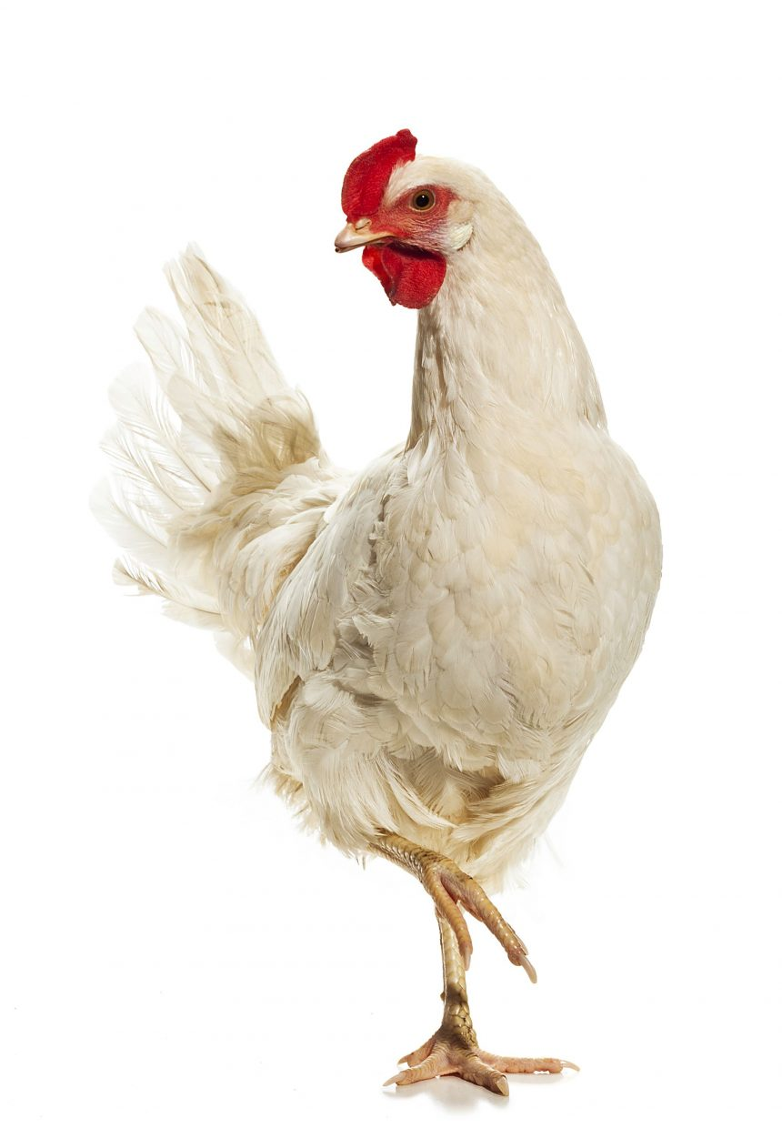

Slide 20
SMALL PLOT RESEARCH
2016-2019 winter wheat growing seasons (4 seasons):
161 field trials
47 research projects
4,000-6,000 small plots per year
8-10 locations per year (central and western KS)
Some locations in OK (?)
Two major areas:
Applied management to reduce yield gaps
Applied wheat physiology

Slide 21
VARIETY RESPONSE TO MANAGEMENT
20 site-years (KS, OK, and TX) – 17 presented here.
20 to 55 varieties per site.
Two management strategies
Standard Management (SM):
N rate for a yield goal of 4.7 Mg ha⁻¹.
Intensive Management (IM):
SM + 45 kg N ha⁻¹ (yield goal of 6.9 Mg ha⁻¹) and two fungicide applications (jointing + heading).
De Oliveira Silva et al. In preparation.

Slide 22
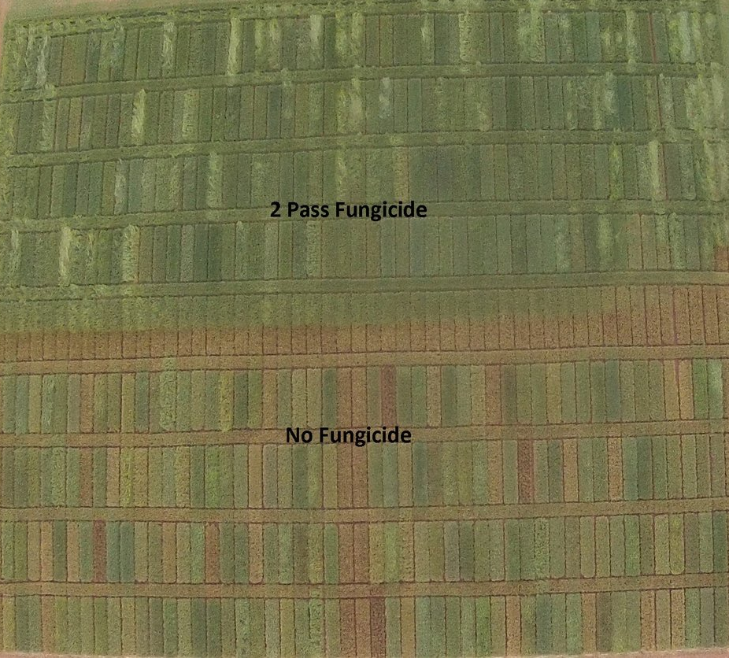
Intensive Management
Standard Management
Photo courtesy of Brian Arnall, OSU Soil Fertility Extension Specialist

Slide 23
-90
-45
0
45
90
Bu/ac
De Oliveira Silva et al. In preparation.

Slide 24
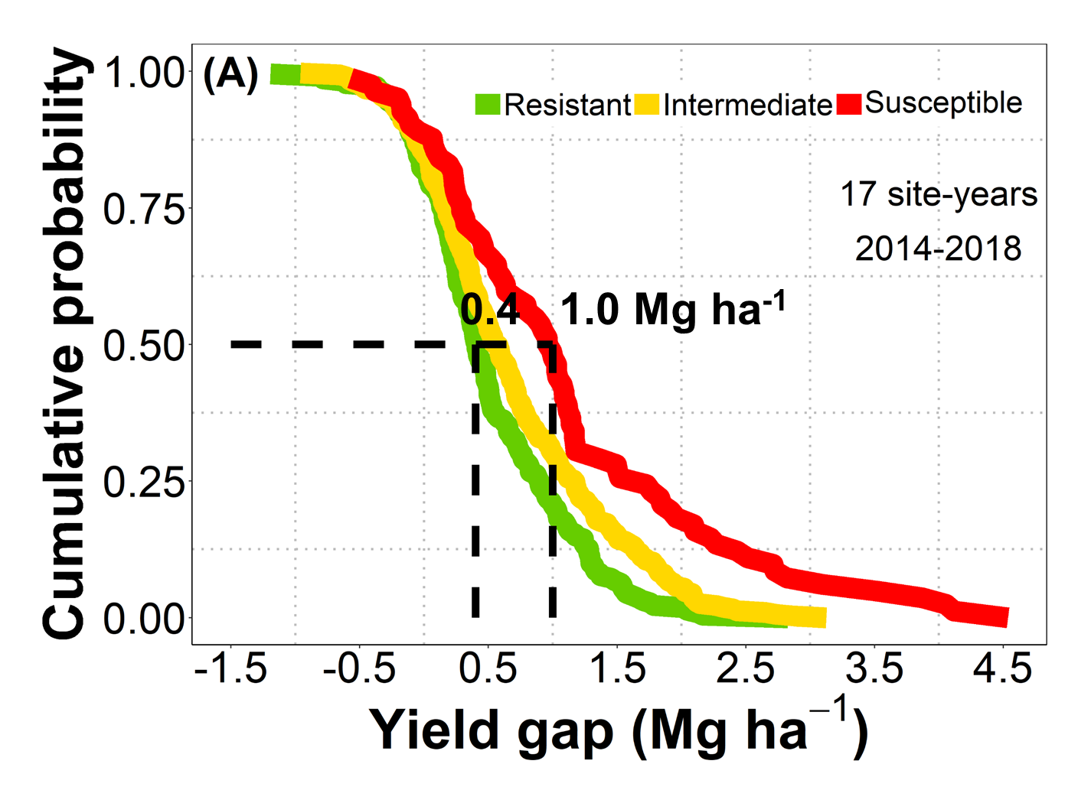
23
8
8
23
37
52
67
Bu/ac
De Oliveira Silva et al. In preparation.

Slide 25
PERCENT GREEN CANOPY COVER (CANOPEO)
Susceptible with Fungicide
Susceptible without Fungicide
De Oliveira Silva et al. In preparation.

Slide 26
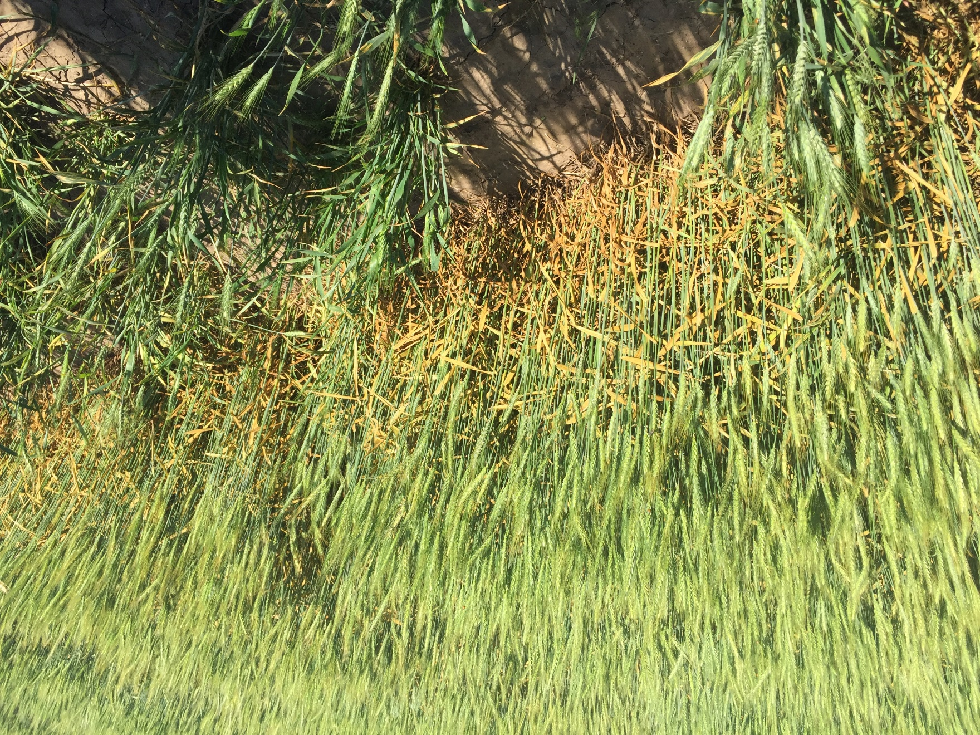
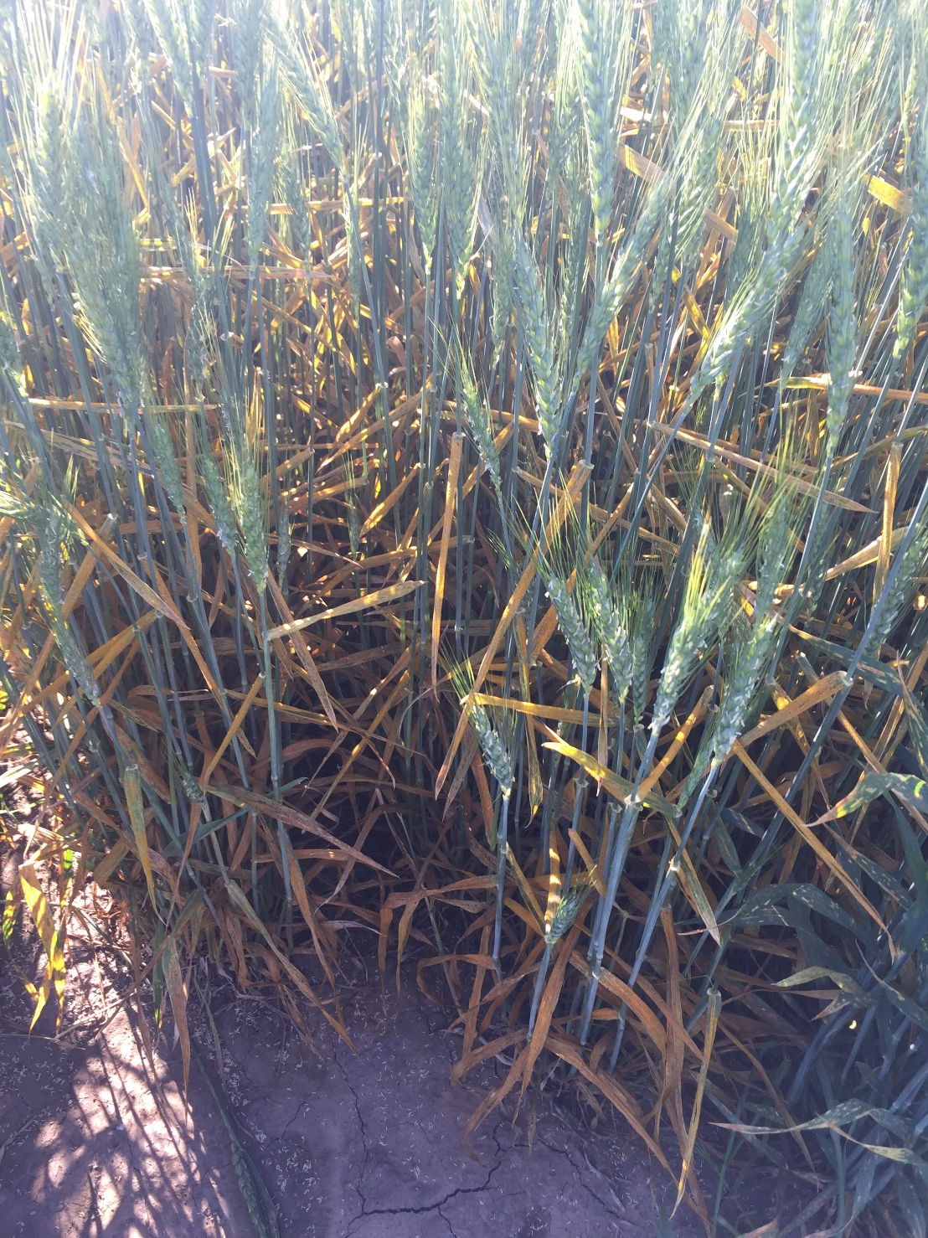
De Oliveira Silva et al. In preparation.

Slide 27
Belleville (06-07-17)
Hutch (05-18-17)
De Oliveira Silva et al. In preparation.

Slide 28
30
60
90
120
Bu/ac
De Oliveira Silva et al. In preparation.

Slide 29
De Oliveira Silva et al. In preparation.

Slide 30
De Oliveira Silva et al. Frontiers in Plant Sciences.

Slide 31
De Oliveira Silva et al. Frontiers in Plant Sciences.

Slide 32
Munaro et al. Under review.

Slide 33
Source of variation | Region
 | All | 1 | 2 | 3 | 4 | 5 | 6 | 7 | 8 | 9 | 10 | 11
 | % influence on yield
Region | 46 | - | - | - | - | - | - | - | - | - | - |  | -
Agronomic practices | 32 | 66 | 57 | 62 | 63 | 53 | 66 | 58 | 77 | 44 | 61 |  | 70
Year | 7 | 13 | 23 | 28 | 30 | 37 | 30 | 31 | 17 | 27 | 22 |  | 21
Genotype | 2 | 2 | 3 | 1 | 2 | 2 | 1 | 3 | 1 | 8 | 3 |  | 4
Residual + Interaction | 13 | 19 | 17 | 9 | 5 | 8 | 3 | 8 | 5 | 21 | 14 |  | 5
Munaro et al. Under review.

Slide 34
McPherson south to north-central OK
Fungicide
Yes
No
Dual-purpose
Yes
No
Sowing date
< Oct. 5
> Oct. 5
5-13rd Oct.
Sowing date
< Oct. 13
> Oct. 13
61
36
39
48
42

Slide 35
Central Kansas (Salina – Gt. Bend)
Fungicide
Yes
No
Prev. Crop
Wheat, fallow
Corn, milo
Sowing date
7th Oct.
<Oct. 7
>Oct. 7
82
65
45
58

Slide 36
Variety characteristics and wheat yield
Munaro et al. Under review.

Slide 37
Irrigated
Stripe rust
Coleoptile length
Straw strength
Winterhardiness
Dryland
Drought tolerance
Coleoptile length
First hollow stem
Stripe rust
Western trials
Fungicide
Medium to Late heading
Drought tolerance
Acid soil tolerance
Medium to short height
No fungicide
Stripe rust tolerance
Leaf rust tolerance
Fall grazing potential
Early heading date
Drought tolerance
Munaro et al. Under review.

Slide 38
Munaro et al. Under review.

Slide 39
Sept.
25th
Oct.
8th
Oct.
10th
Oct. 10th
Sept. 29th
DOY 283
Oct. 3rd
Oct.
13th
Oct.
13th
Oct.
12th
Oct.
18th
Oct.
20th
Munaro et al. Under review.

Slide 40
Sulfur balance
SINCE 2000
S removal by wheat
greater than
S atmospheric deposition
Mining Soil S
Data courtesy: Dr. Mary Guttieri
S removal based on average KS wheat yields (0.08 lb S/bu)
S deposition based on S concentration at Konza precipitation station

Slide 41
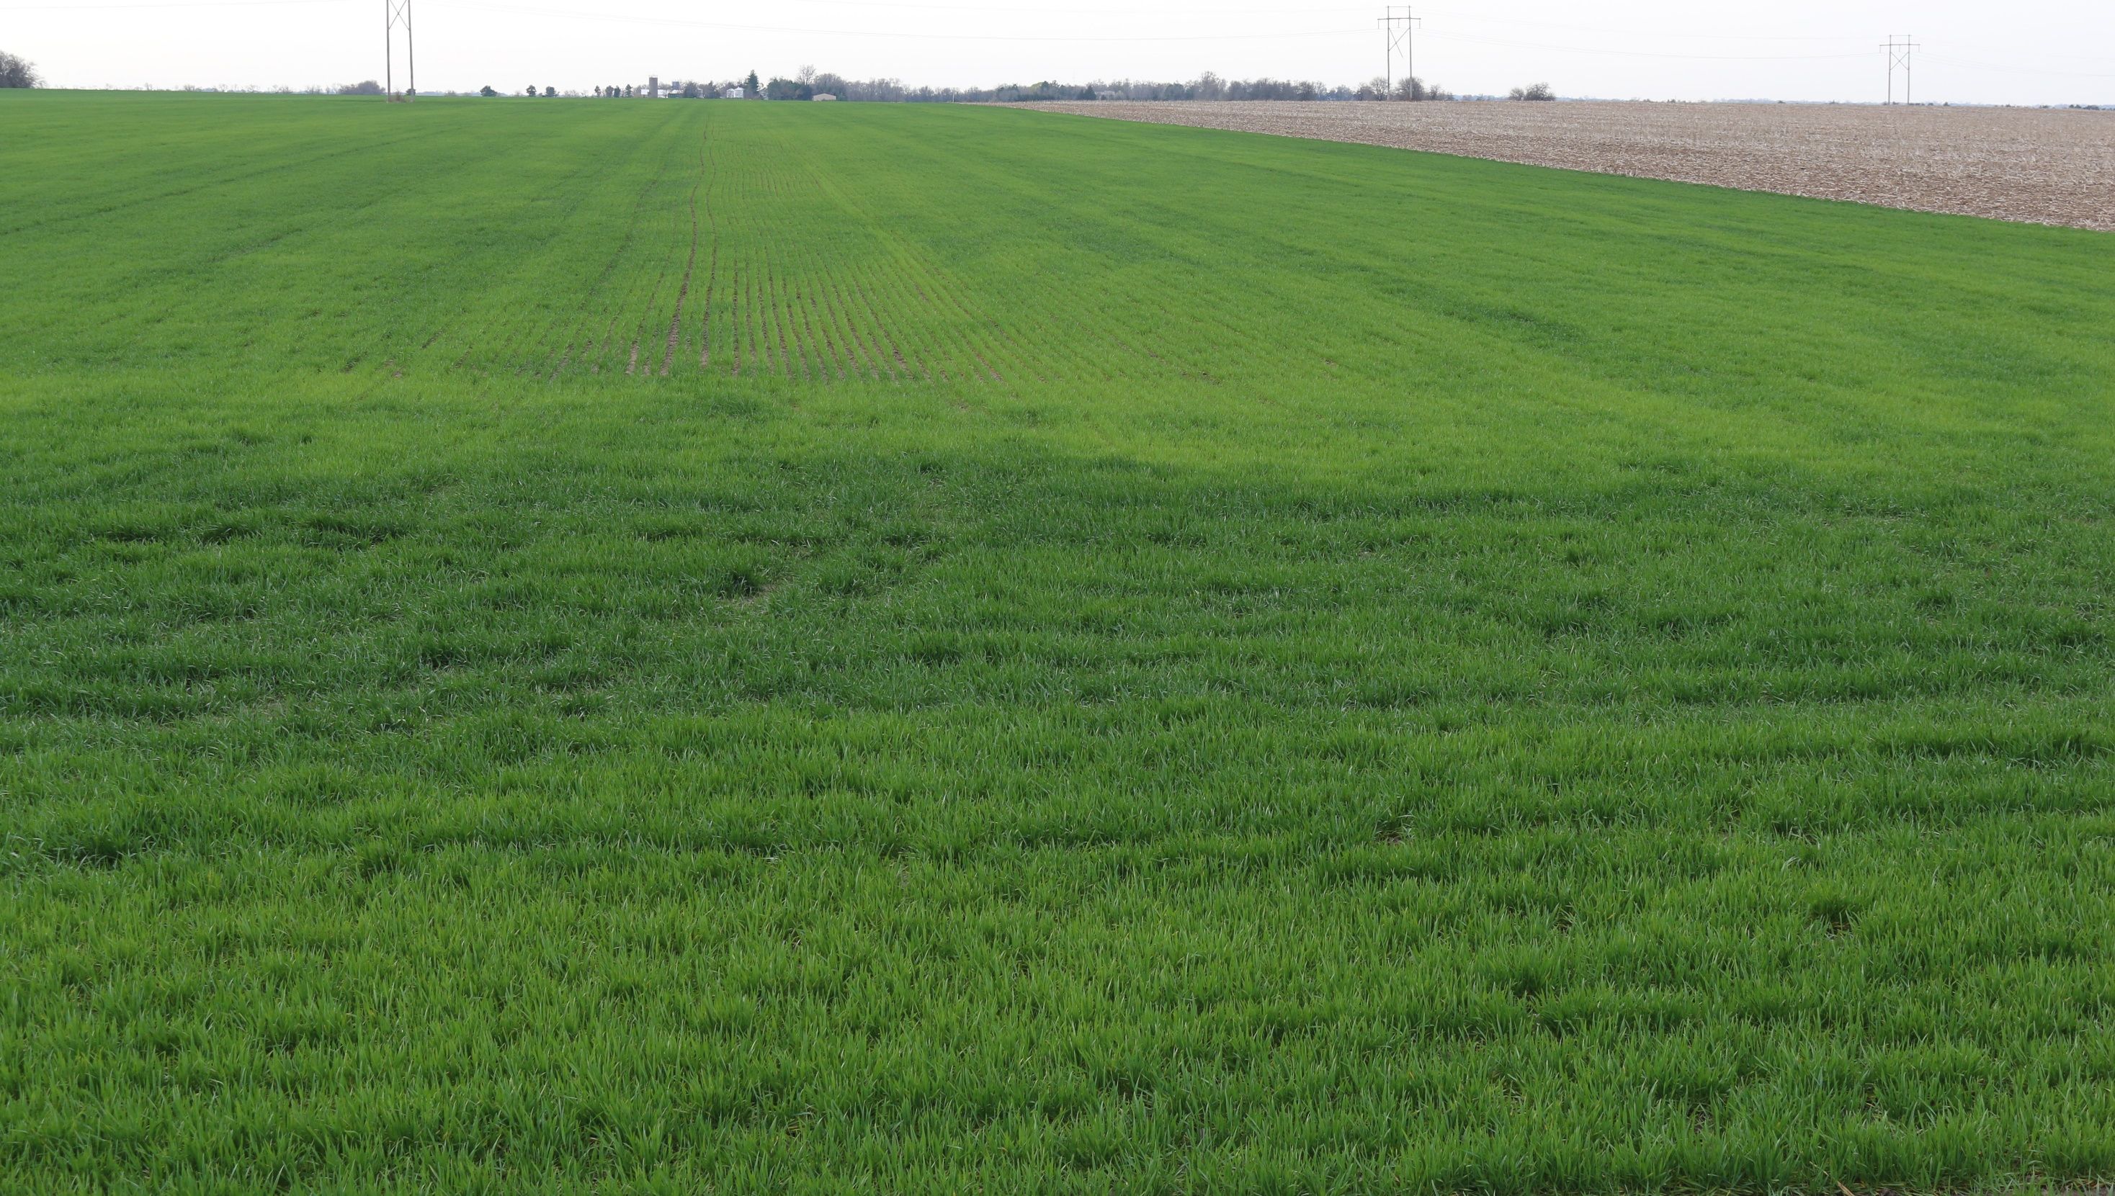
SULFUR DEFICIENCY

Slide 42
Nitrogen x Sulfur x Variety
Objectives:
To understand the impact of different N and S rates on wheat grain yield and quality, and whether these depend on wheat variety.
Three field seasons (9 site-years)
2018: Manhattan and Belleville
2019: Ashland Bottoms, Belleville, and Hutchinson
2020: Ashland Bottoms, Hutchinson, Belleville, and Conway Springs
Three N rates, four S rates, and 3 varieties

Slide 43
Grain Yield

Slide 44
Grain Protein

Slide 45
OTHER RESEARCH
Wheat variety response to scab inoculation and fungicide
Wheat variety by management interactions (different management levels)
Wheat variety response to N rates and fungicides (separately)
Plant growth regulators by fertility interactions
Wheat variety response to seeding rate
Wheat response to seed cleaning and seed treatment (fungicide/insecticide)
Soft versus hard winter wheat for eastern Kansas
Historical yield gains from varieties released in Kansas (1920-present)

Slide 46
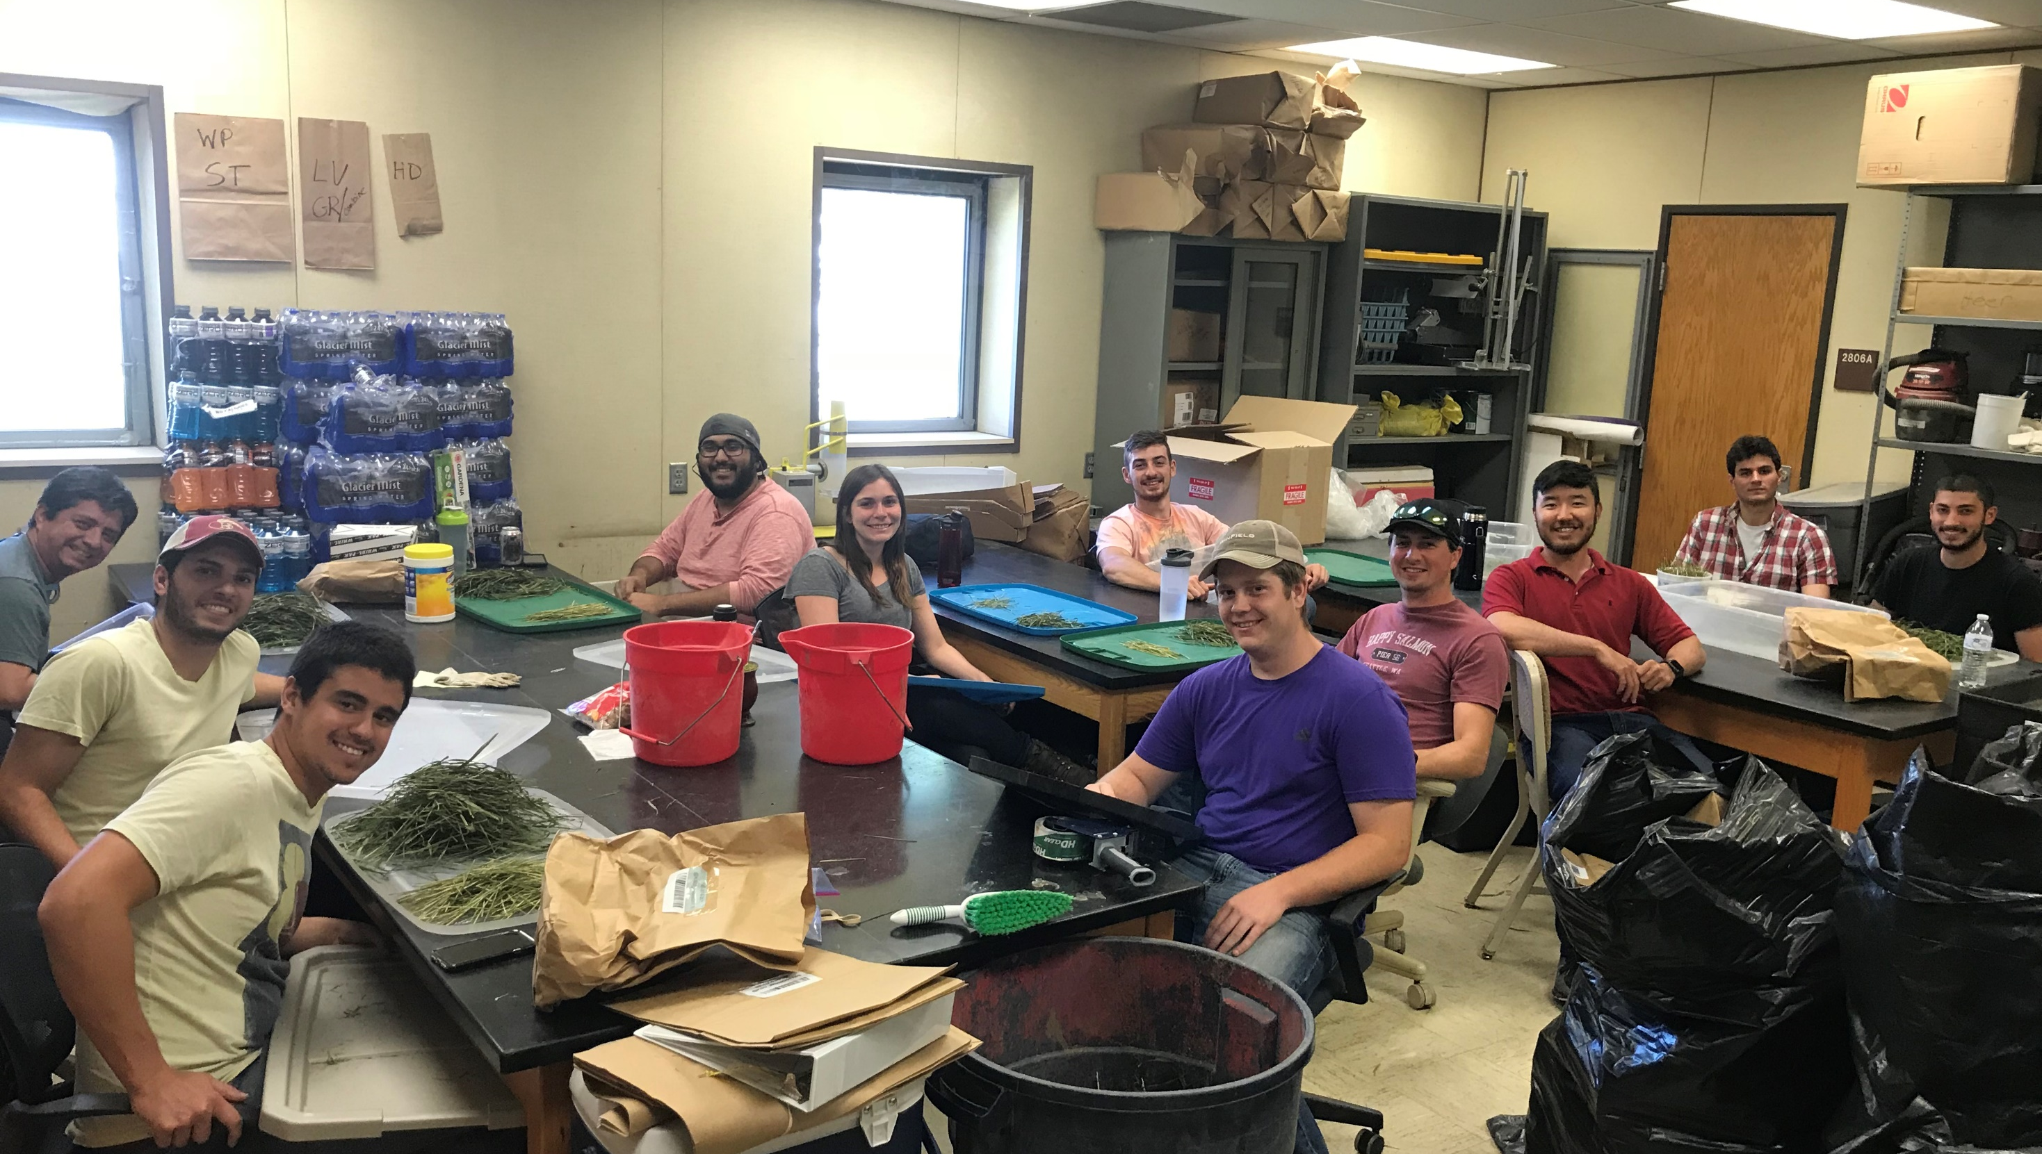

Slide 47
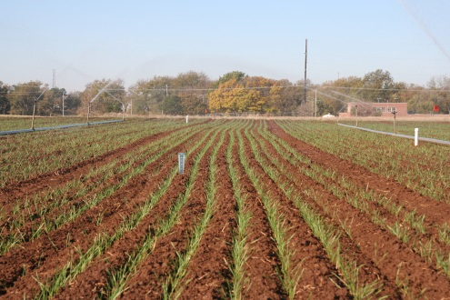
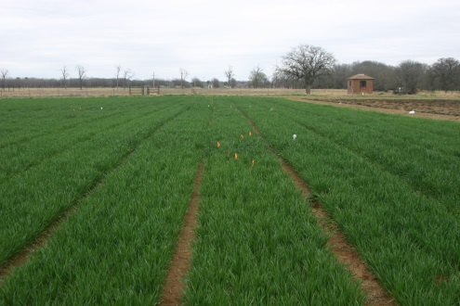
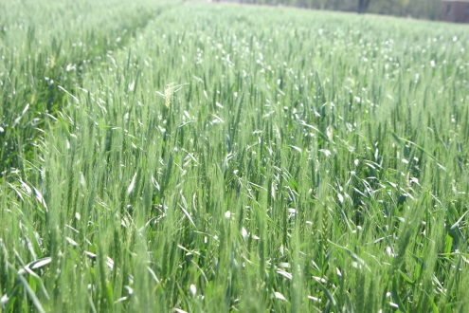
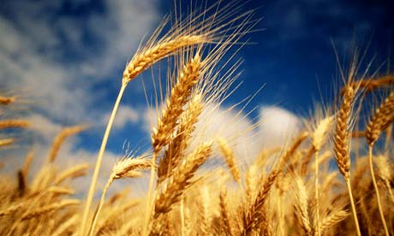
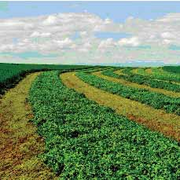
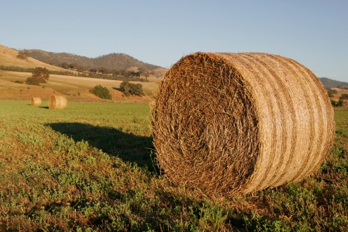
QUESTIONS?
Romulo Lollato, Ph.D.
Assistant Professor, Extension Wheat and Forages Specialist
Kansas State University
lollato@ksu.edu
@KSUWheat
KSU Wheat

