Slide 1
2019 NE Region Update
Stu Duncan
November 25, 2019

Slide 2
Chicken Poop for the Soil

Slide 3
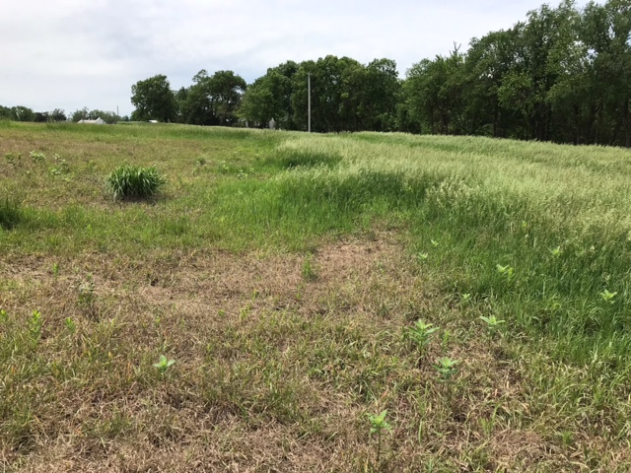
Johnson County Brome
Weed control
Broomsedge bluestem
Foxtails
Hemp dogbane

Slide 4
Cover Crop Plot – Rice Co., May 7

Slide 5
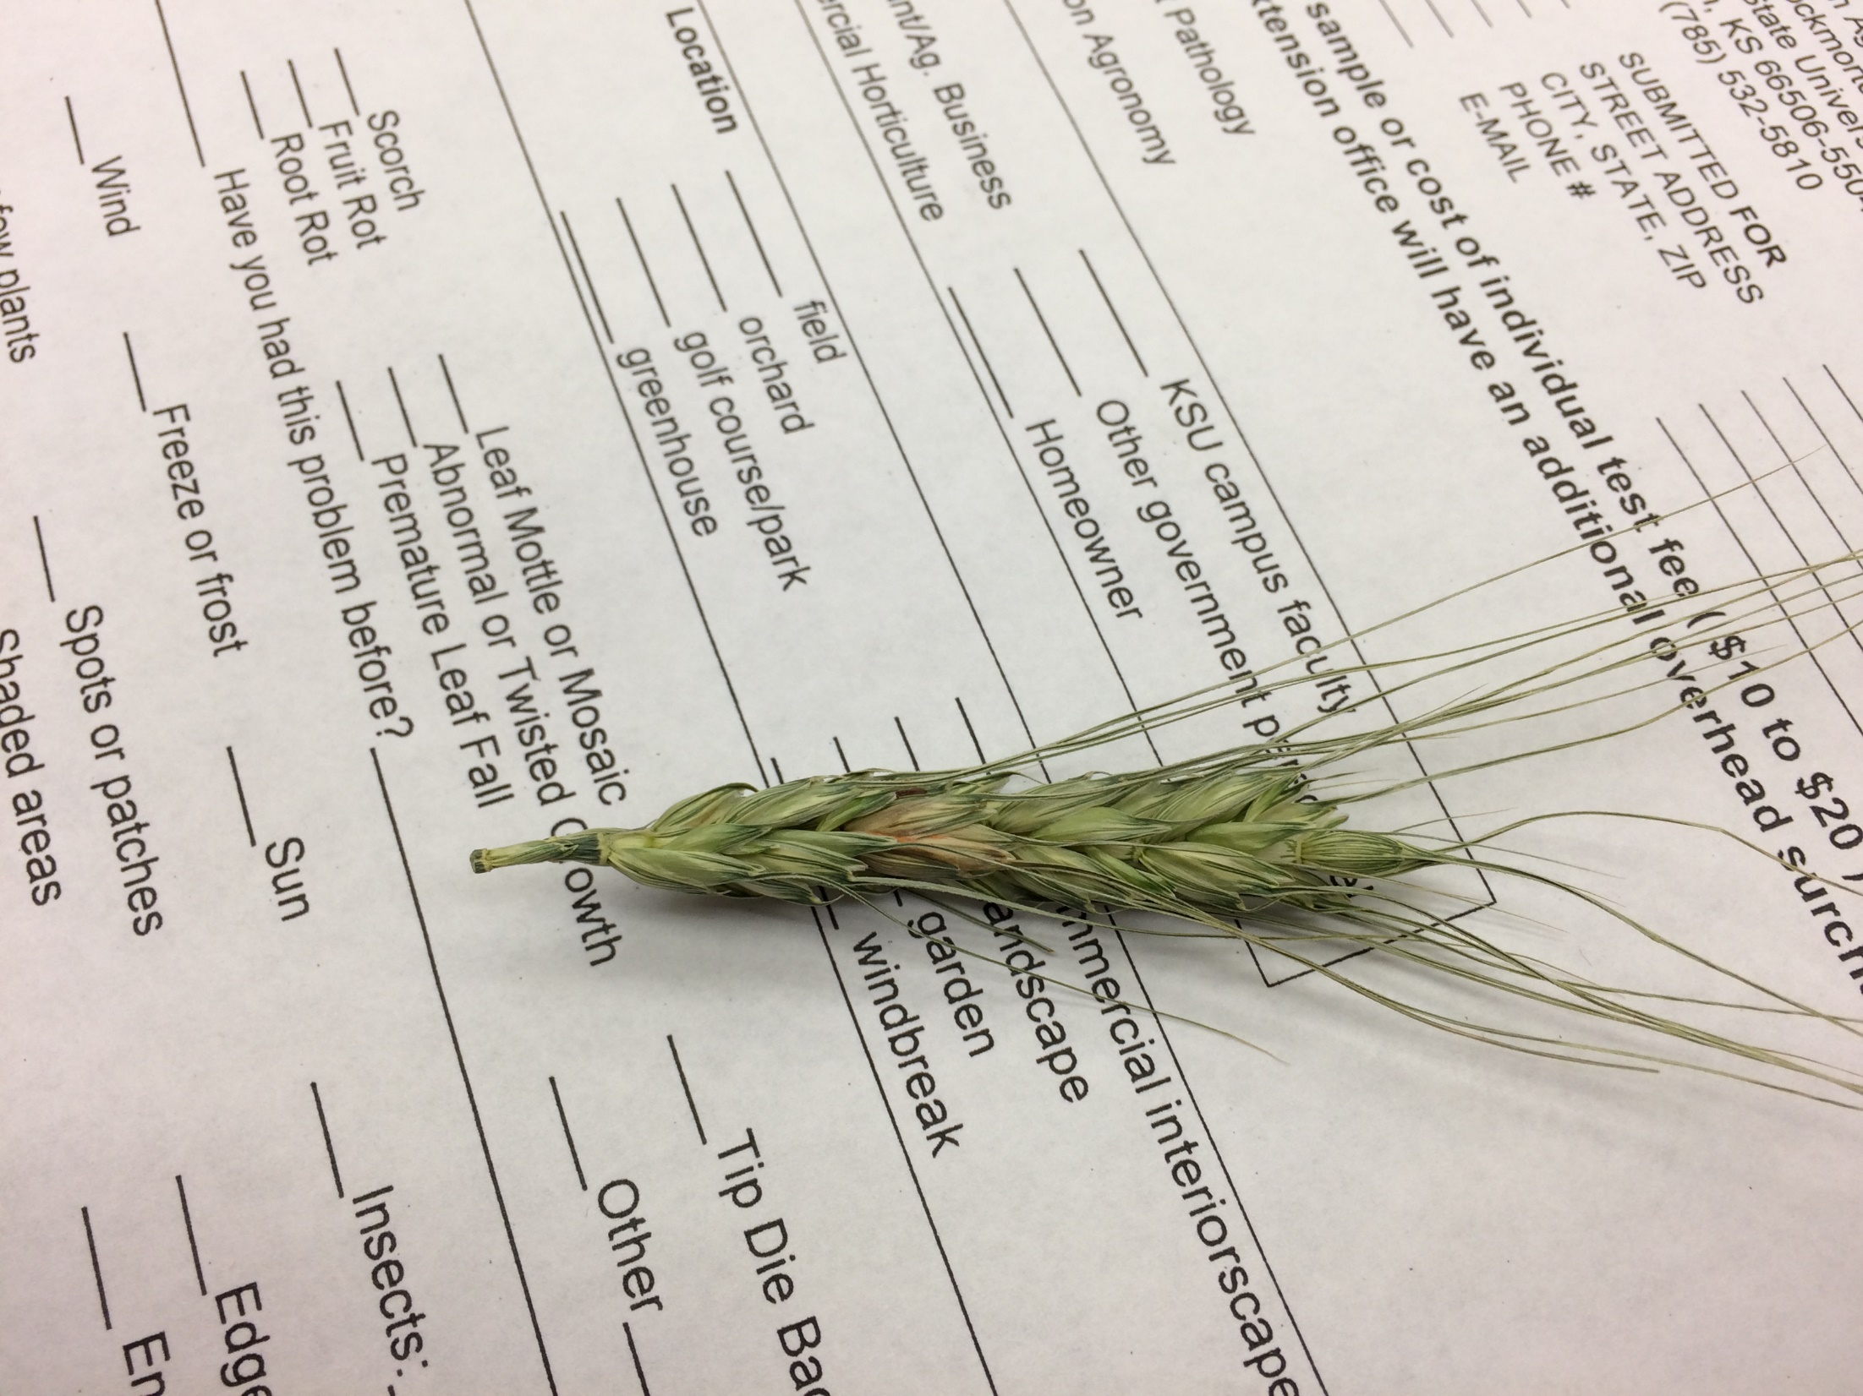
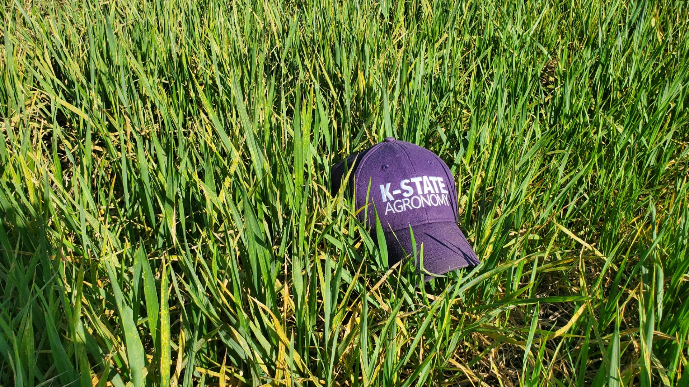
Central Kansas Corridor Wheat

Slide 6
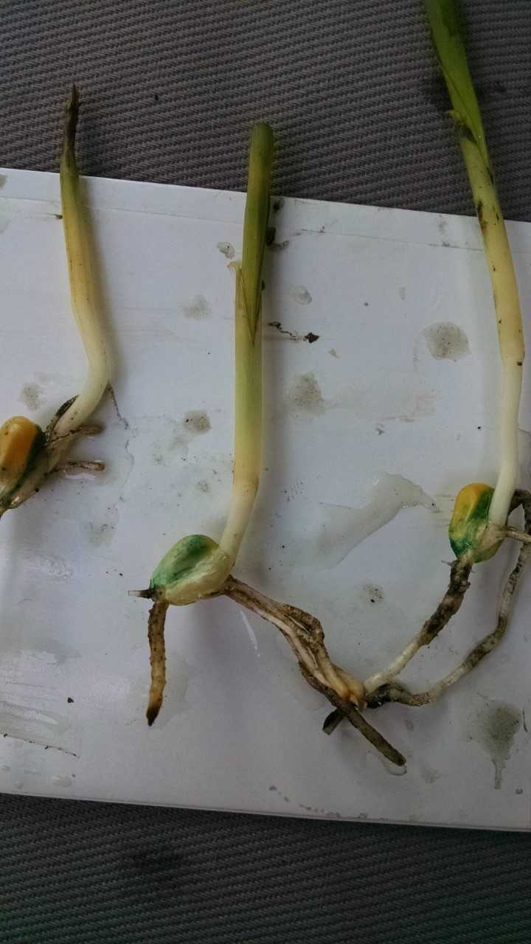
Anhydrous Ammonia Issues MED, May 14

Slide 7
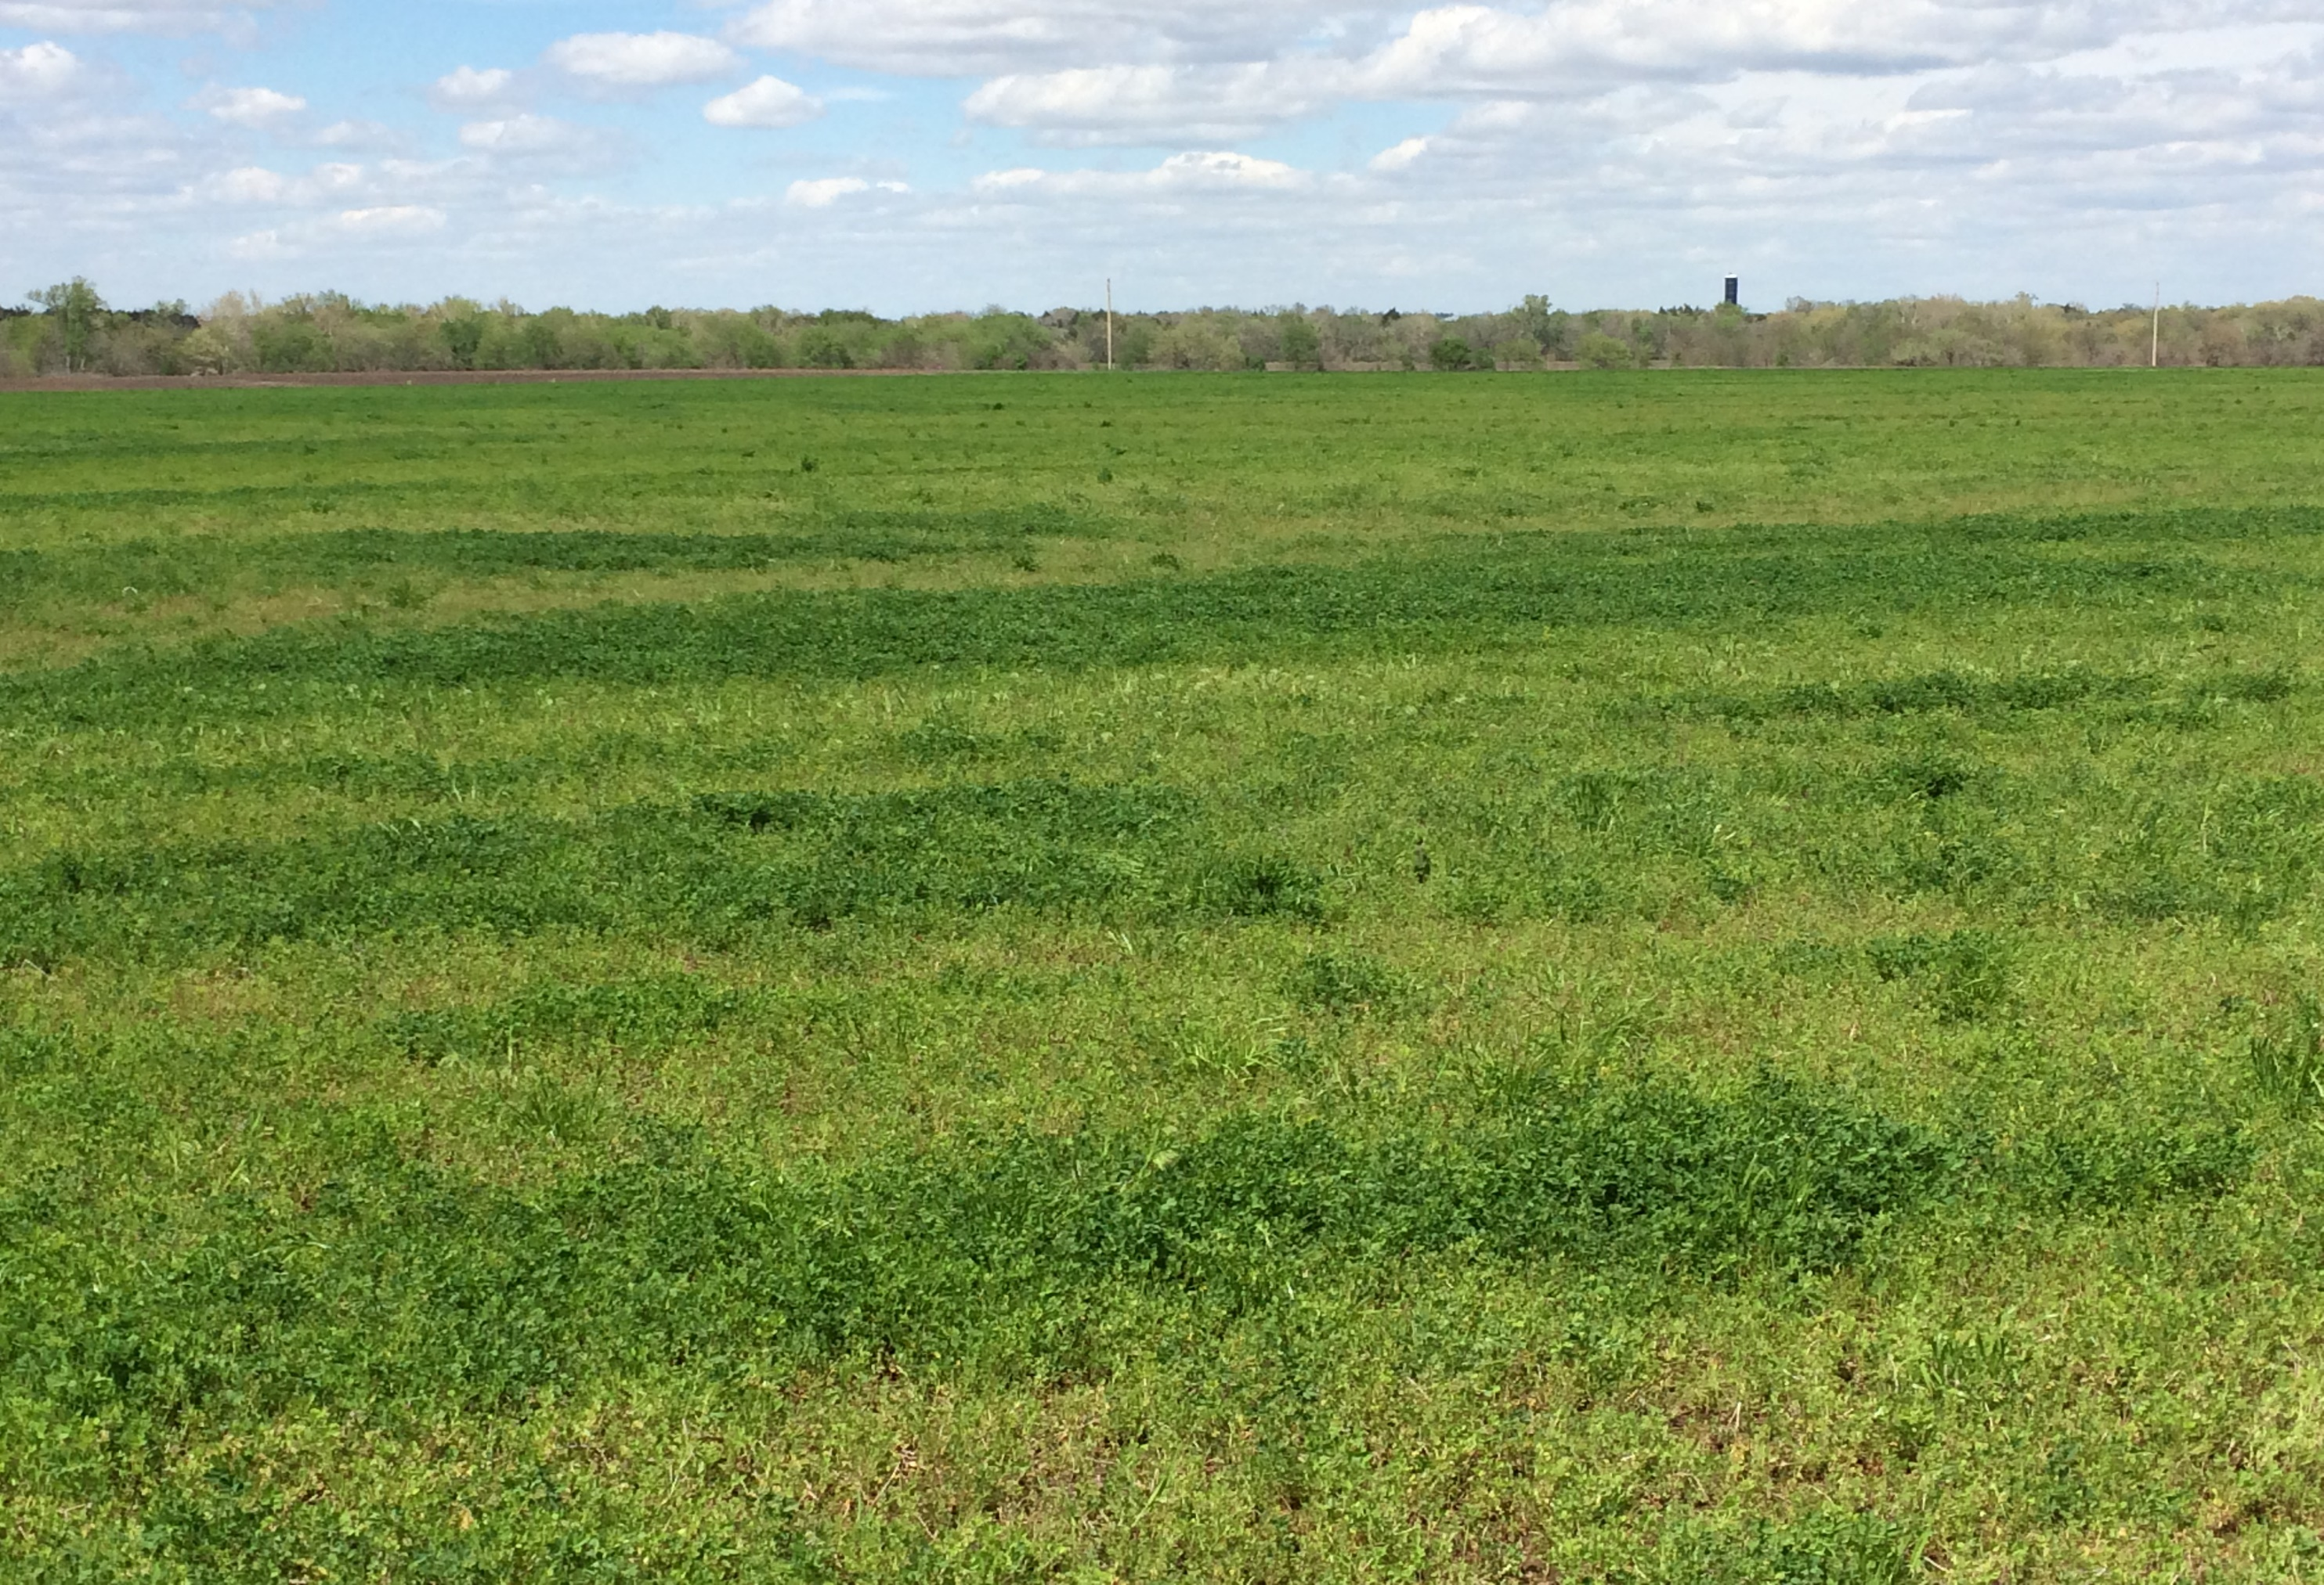
Seedling Alfalfa – AN Co., April 18

Slide 8
Season Long Oddities – Geary Co.

Slide 9
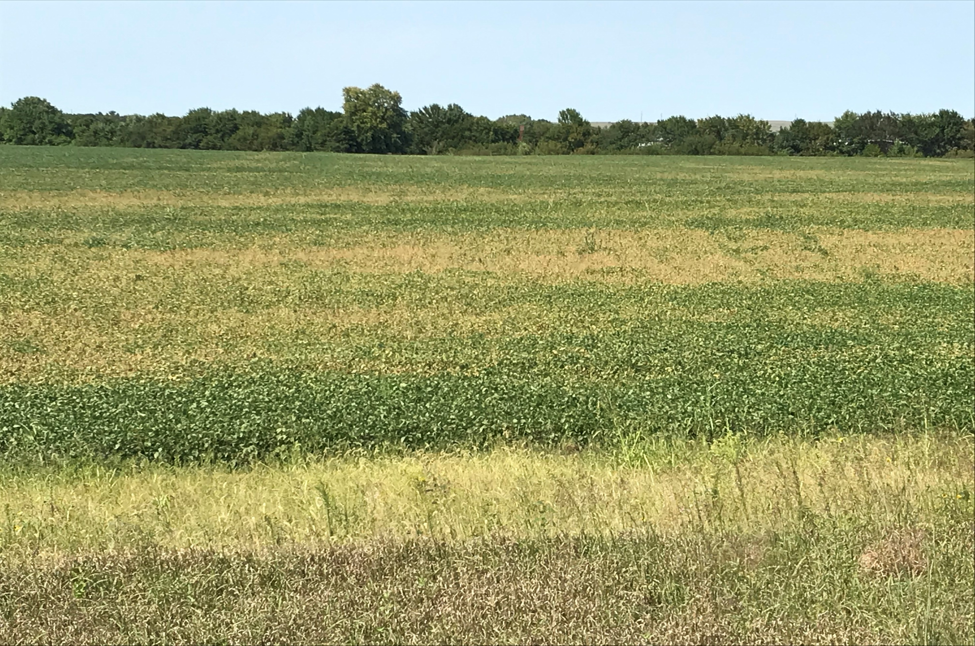
Soybeans – SDS, Charcoal Rot, ..

Slide 10
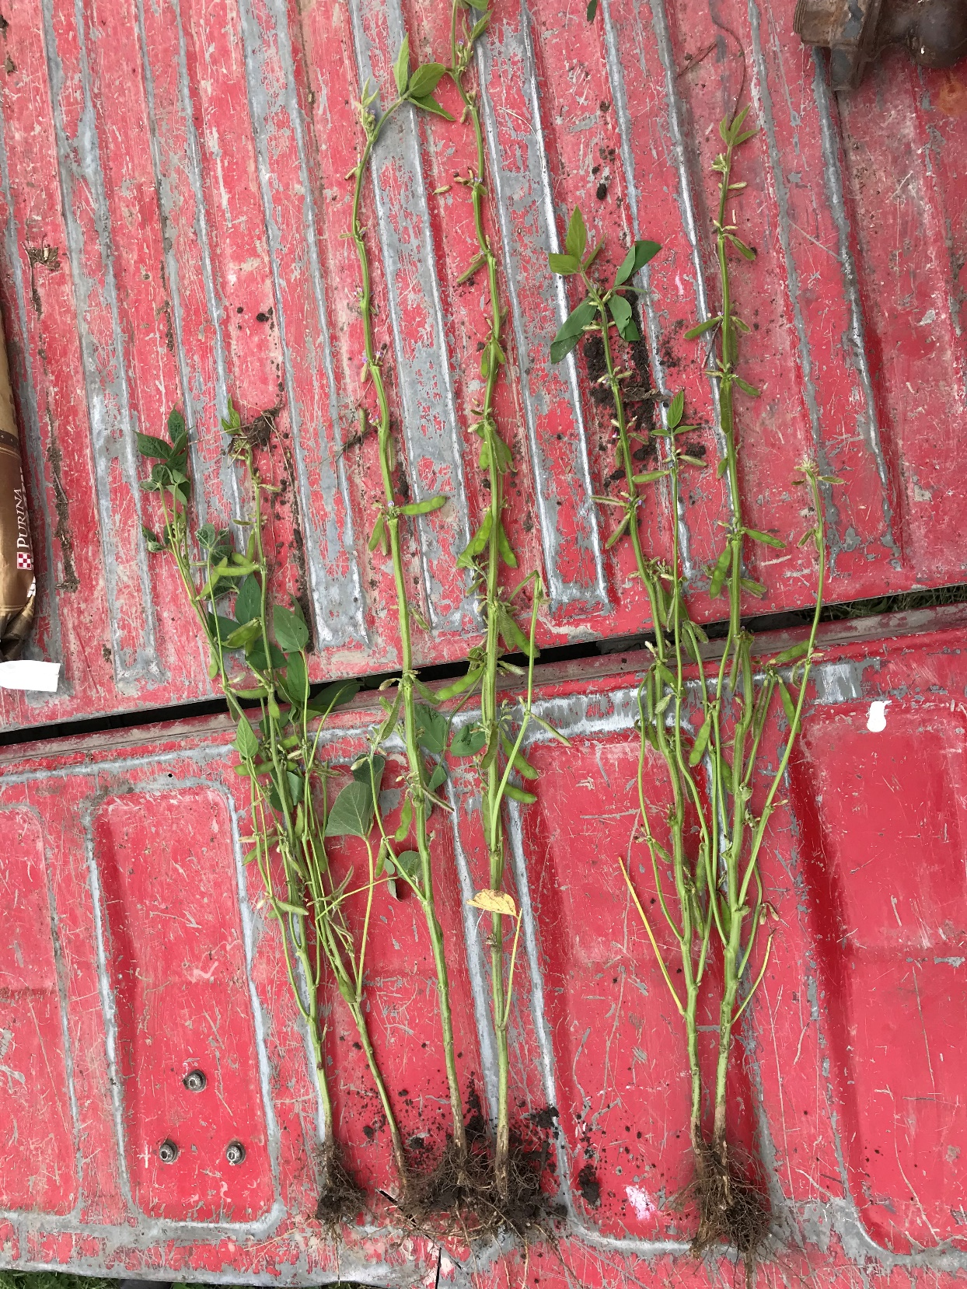
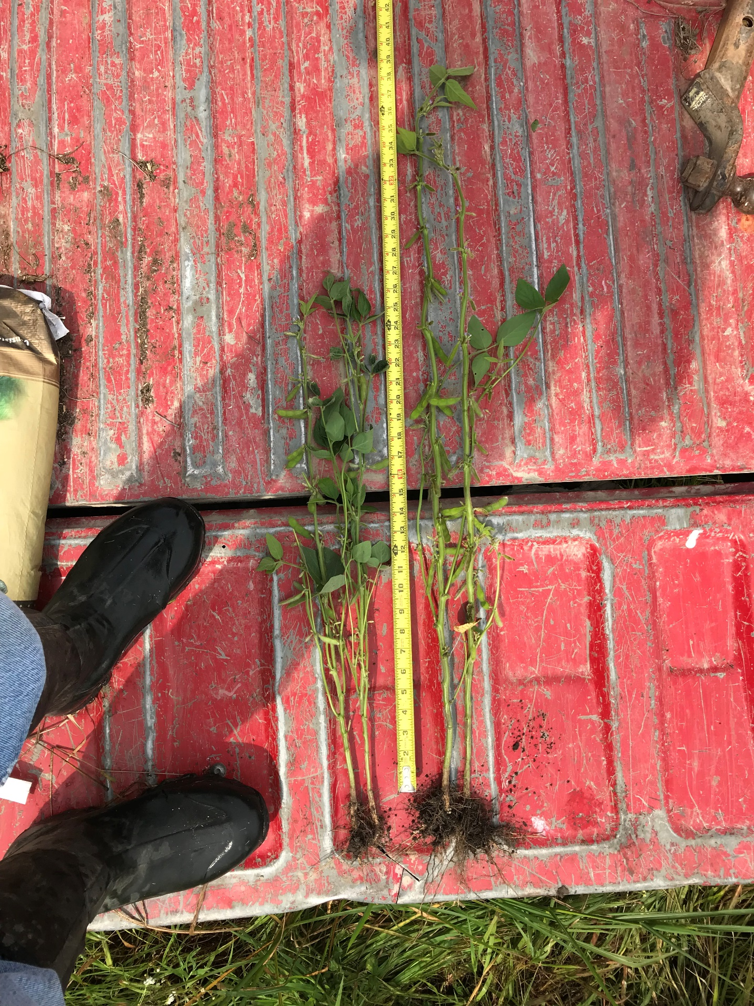
Diacamba 3.0 Douglas County

Slide 11
Ambient Dicamba Drift – Year 2

Slide 12
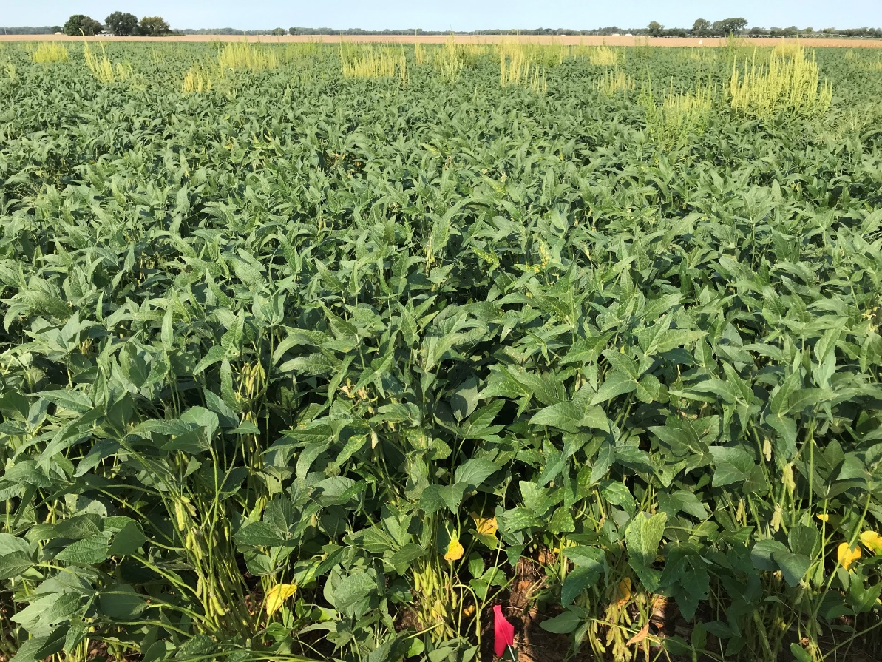
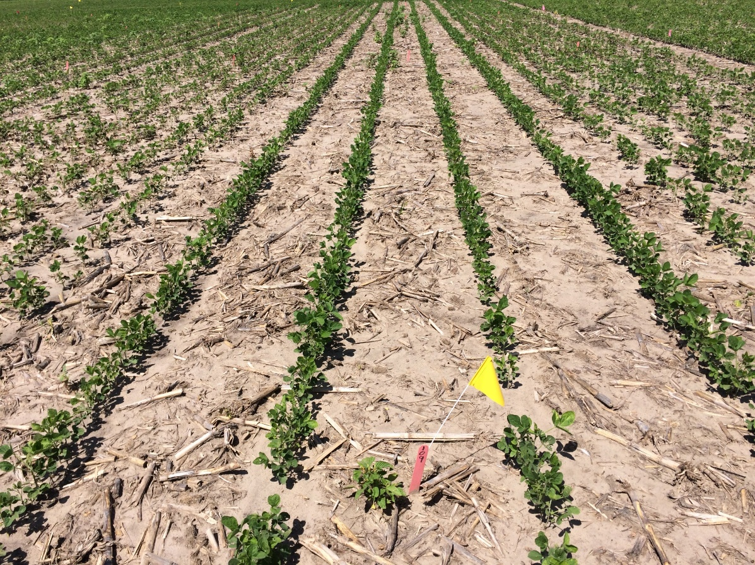
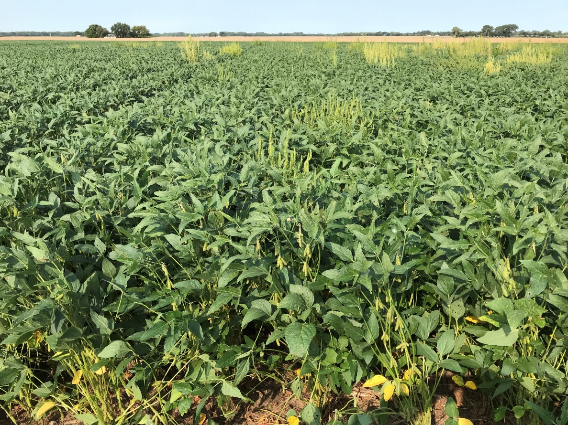
Planted June 4
Preemerge – 6 oz Authority Maxx +
1.5 pt Dual II Magnum +
24 oz Roundup Weathermax
Harvested October 15
30” rows 15” rows
UTC 65 bu 68 bu
Plot Avg. 67 bu 70 bu
Range 64-70 60-75

Slide 13
Post Emergence X Row Spacing
Row Width | Herbicide | Rate | Timing | Yield, bu/a
15 | UTC |  |  | 68 ab
15 | Cobra | 11 oz | 21 DAP | 60 b
15 | Cobra + Glyphosate | 11 oz + 39 oz | 21 DAP | 67 ab
15 | Cobra | 11 oz | 35 DAP | 75 a
15 | Cobra + Glyphosate | 11 oz + 39 oz | 35 DAP | 75 a
30 | UTC |  |  | 65 ab
30 | Cobra | 11 oz | 21 DAP | 68 ab
30 | Cobra + Glyphosate | 11 oz + 39 oz | 21 DAP | 68 ab
30 | Cobra | 11 oz | 35 DAP | 64 b
30 | Cobra + Glyphosate | 11 oz + 39 oz | 35 DAP | 70 ab

Slide 23
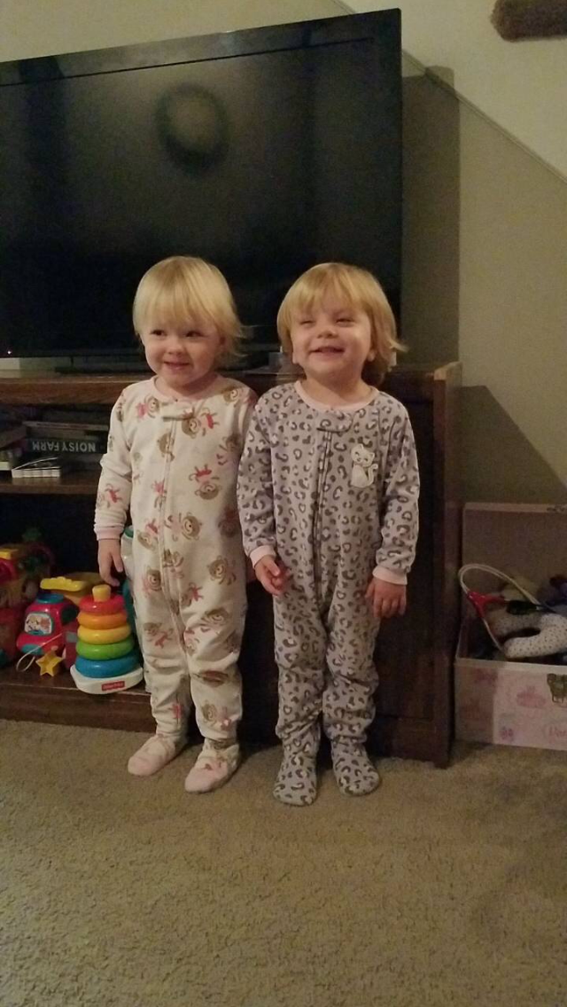
Julia & Eleanor
2 years & 2 months
Charlotte Jo & Declan Dean
October 17 September 9
7 lb, 1 oz 10 lb, 10 oz

