Slide 1
2019 NE Region Agronomy Update
Dorivar Ruiz Diaz
Professor and Soil Fertility Specialist

Slide 2
2019 NE Region Agronomy Update
Soil testing lab
Changes in soil test methods
Phosphorus and soil (health) test methods
Nitrogen soil health test and corn N fertilization

Slide 3
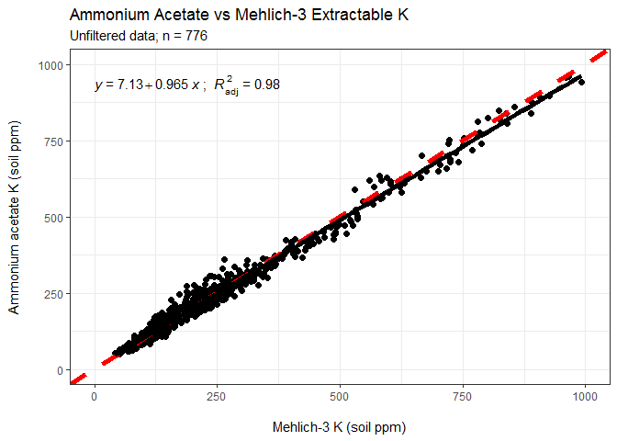
Soil testing lab: analysis methods
New in 2019: switched from ammonium acetate K to Mehlich 3 K

Slide 4
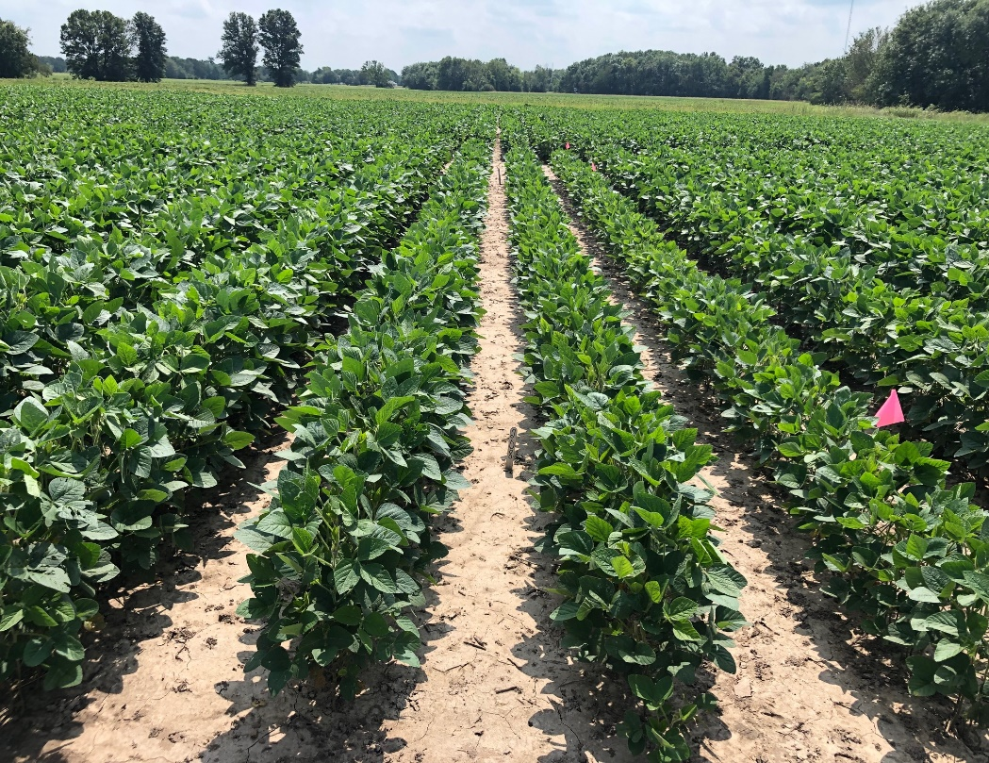
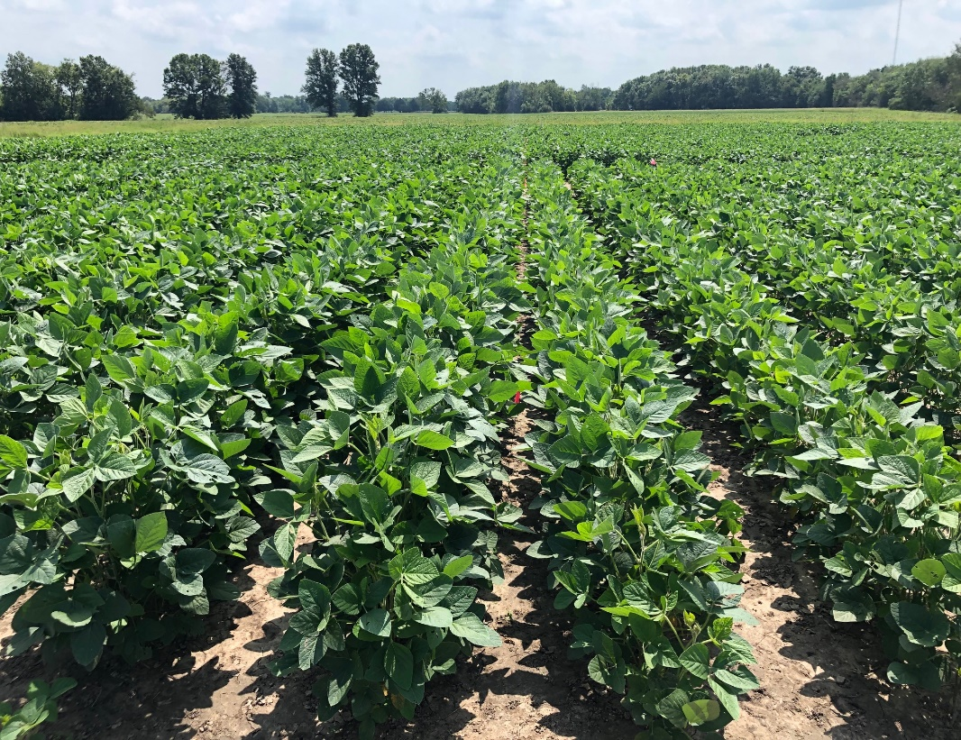
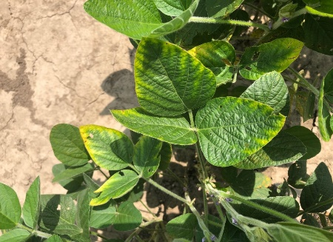
Field evaluations and methods for K
Ongoing soybean K study
Evaluation of alternative test methods (moist test)
Clay types and the effect on K critical value (currently at 130 ppm)
Control (no P o K)
150 lbs K2O + 80 lbs P2O5
150 lbs K2O

Slide 5
Soil testing lab: analysis methods
In 2020 evaluations/updates of methods:
Sulfur
Micronutrients
Cation exchange capacity

Slide 6
Soil testing lab: analysis methods
Soil testing survey
To represent the most common soils across Kansas
Focus on surface (0-6 in samples) for immobile nutrients, OM and pH.
Evaluation of soil test methods and performance across different KS regions
Lab results will be provided to contact person, for individual samples and compiled results.
Fertilizer recommendations update: under review, new version with revisions for N only

Slide 7
Phosphorus soil test method (including soil health test methods) – 2019
Weber and Ruiz Diaz 2019

Slide 8
Response to broadcast P pre-plant wheat – 2019 data
Early biomass
Grain yield

Slide 9
High soil pH affect correlation among soil test P methods
Bray 1 vs Mehlich 3
Olsen vs Mehlich 3
Weber and Ruiz Diaz 2019

Slide 10
Haney Test (H3A) vs Mehlich 3
Haney H3A vs Mehlich 3
Weber and Ruiz Diaz 2019

Slide 11
Critical values for wheat (2019 data)
Weber and Ruiz Diaz 2019

Slide 12
P and K fertilizer recommendations moving forward
Potassium:
Do we need different critical values for different soils?
The need for different test methods
Ongoing for soybean, also evaluate corn ?
Phosphorus
Critical values for different crops: corn, soybean and wheat
Provide calibration for different methods (not just Mehlich3)

Slide 13
Evaluating relationships between soil CO₂ respiration and nitrogen supply to corn
Bryan Rutter and Dorivar Ruiz Diaz
Dep. of Agronomy,
Kansas State University

Slide 14
Soil health test and nutrient management
Emphasis on soil health as key component for sustainable crop production.
Soils with higher levels of soil organic matter and intensified cropping systems: NT, crop rotations and cover crops.
Chemical soil test/heath indicators are being promoted to provide fertilizer recommendations.

Slide 15
Short-term carbon mineralization: CO₂ respiration, 24 h incubation
Soil microbial biomass and its activity is sensitive to changes in amount and composition of active fractions of SOM.
Soil N supplying potential is related to soil microbial biomass and activity.

Slide 16
Methods: 24 h CO₂ soil lab analysis
Previous method: Solvita using the color change paddles
CO2 measured using gas chromatography:
Samples wetted from the bottom up via capillary action
Wetting the sample more “uniformly” and reduce CO2 variability between replicates.

Slide 17
Methods: Field study
18 locations: 3 years during the 2017-2019 seasons
Contrasting tillage/management:
Conventional tillage and no cover crops
Long-term no-till and cover crops
Nitrogen fertilizer: injected below the residue using UAN

Slide 18
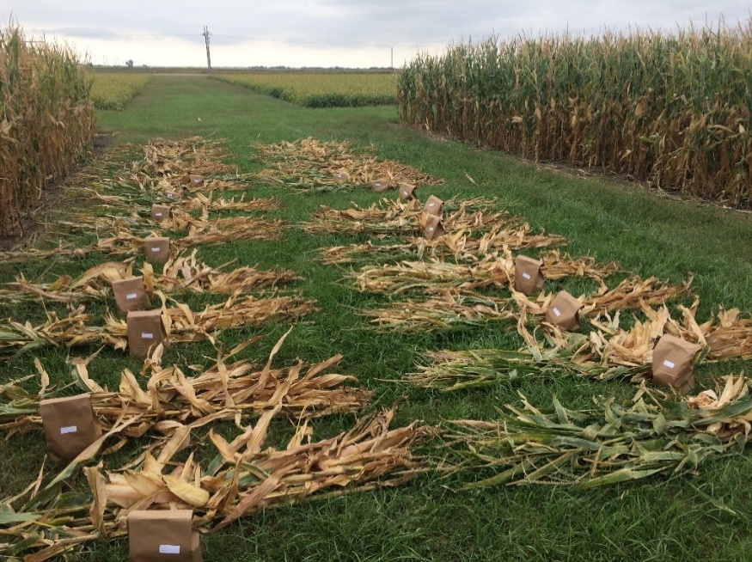
Methods: Field study
N rates: 0, 50, 100, 150, and 200 lbs/a
Soil sampling at the 0-6 and 0-3 in depth.
Corn plant biomass, N concentration and uptake, early season and at maturity.

Slide 19
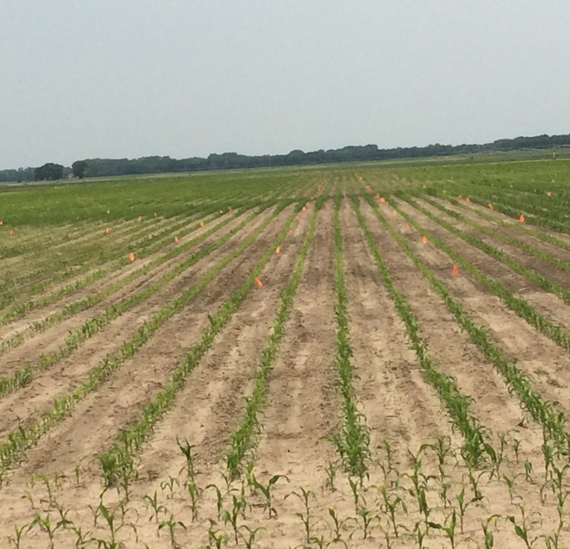
Contrasting locations/management
No-till and cover crop
CT, No cover crop

Slide 20
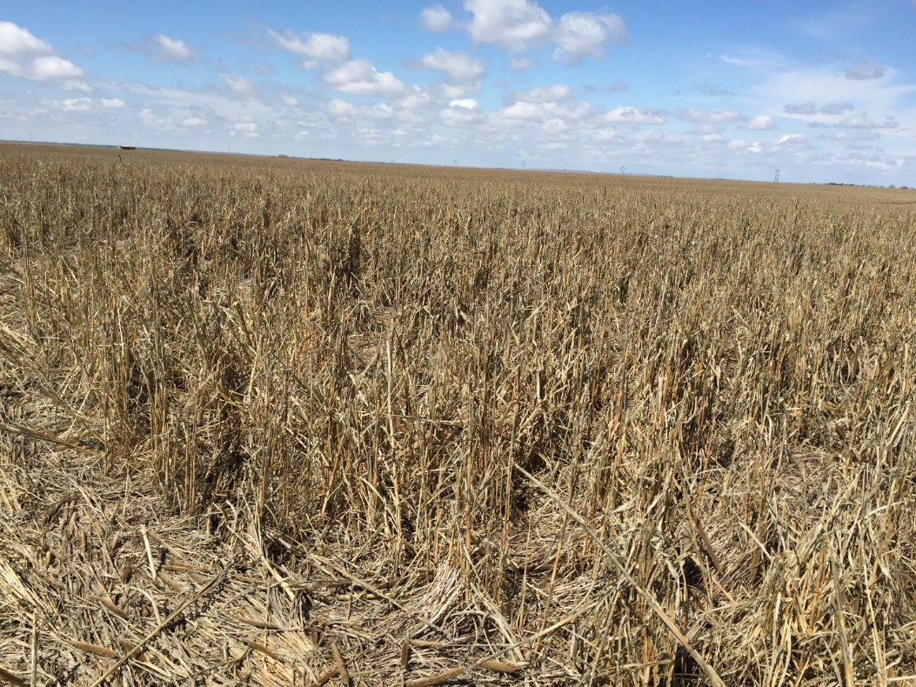
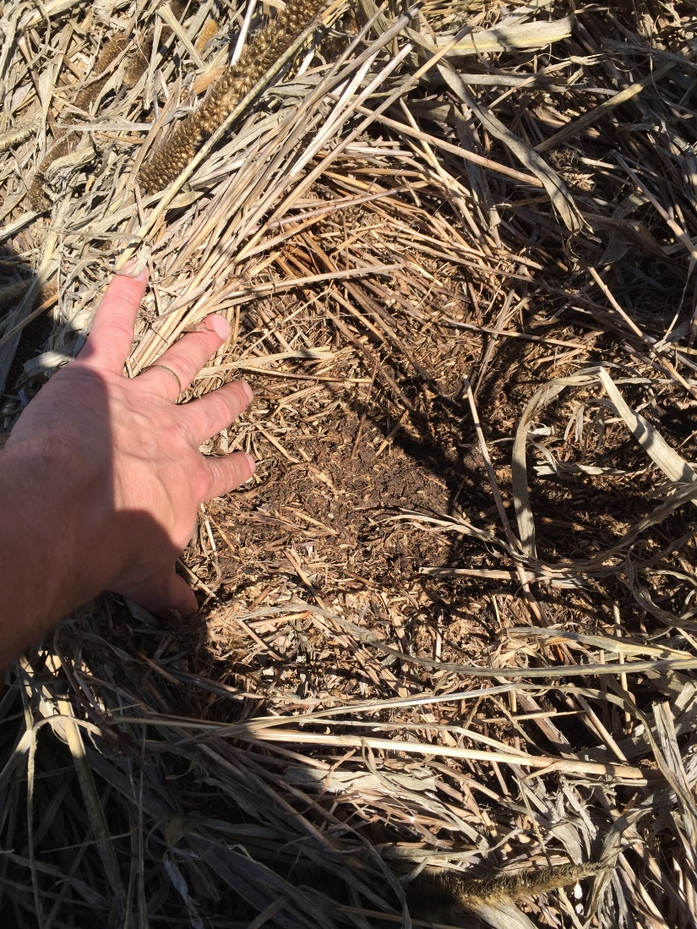
Long-term NT and cover crops (25+ years)
Millet cover crop

Slide 21
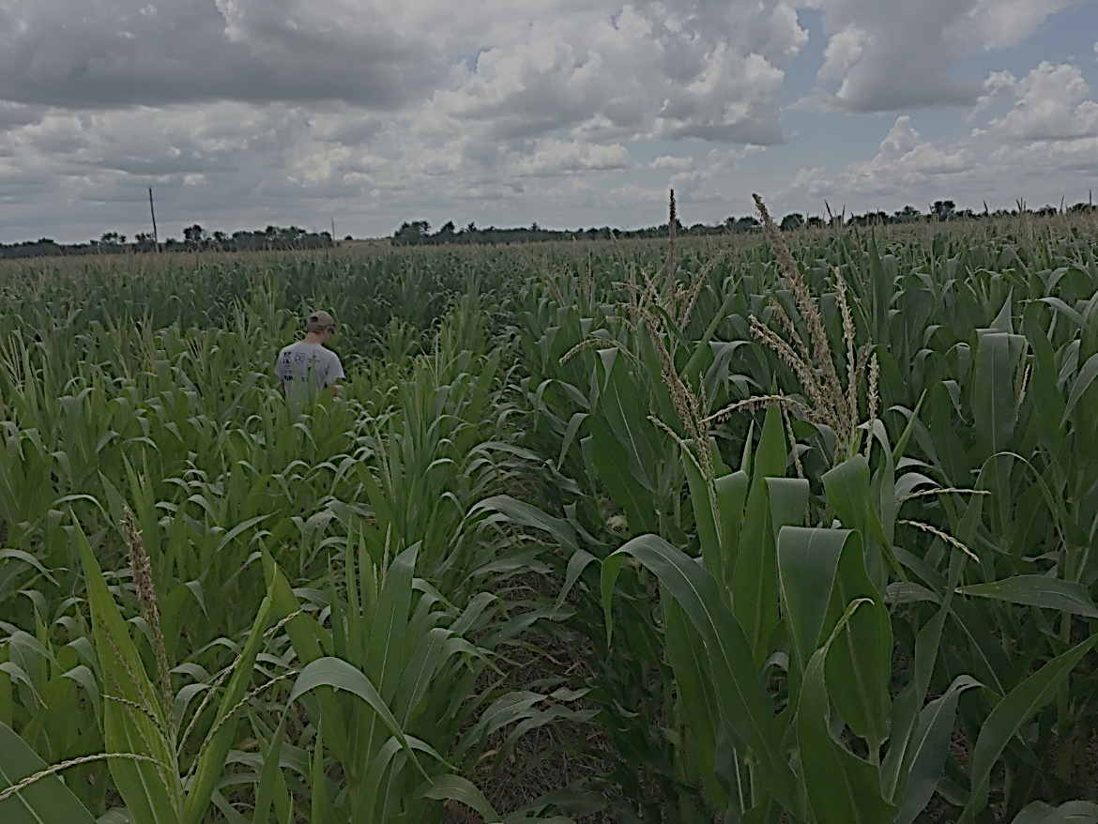
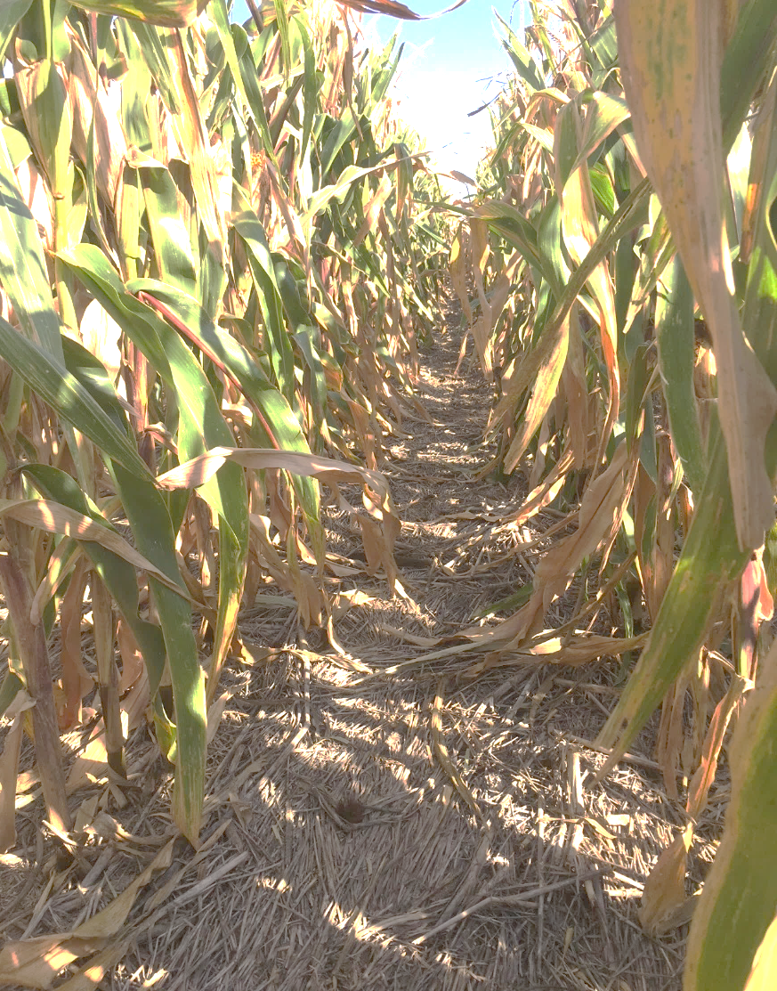
Long-term NT and cover crops (25+ years)
Millet cover crop

Slide 22
Tillage/management system vs CO2 respiration

Slide 23
Effect of soil sampling depth
0-6 inch sampling
0-3 inch sampling

Slide 24
Nitrogen uptake early season (~V6 corn)
*
*
*
*

Slide 25
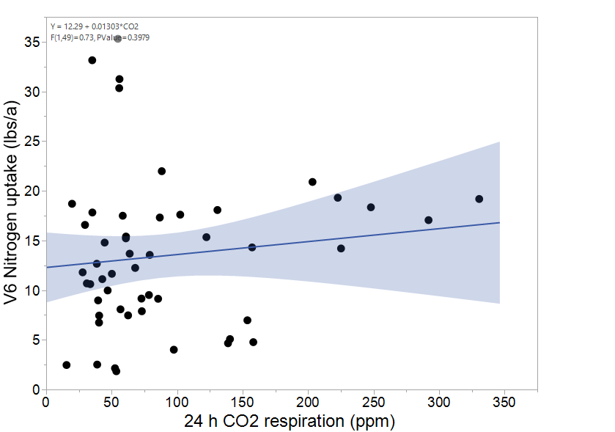
Nitrogen uptake early season (~V6 corn): control plots (no N fertilizer)

Slide 26
Soil CO2 and corn N uptake control plots (no N fertilizer)
N removal (lbs/a)

Slide 27
Soil CO2 and corn grain yield control plots (no N fertilizer)
200
80
80
160
Grain yield (lbs/a)
120
80
80

Slide 28
Optimum N rate as affected by management system
Conventional tillage
Parameter | Estimate
c (plateau) | 123
No-till
c (plateau) | 108

Slide 29
Soil organic matter vs 24 h CO2 respiration

Slide 30
Summary
The 24 h CO2 respiration showed higher values for long-term no-till systems.
Traditional sampling depth for soil fertility (0-6 in) might not be appropriate for CO2 respiration analysis.
Additional sampling in the field (0-3 in) might not be practical.
Overall higher early season plant N uptake (V6) for no-till vs conventional (with same N application rate).

Slide 31
Summary
Soil N supply to corn showed a weak relation to CO2 respiration values (V6 N and grain N).
Better for total plant N uptake at maturity
Grain yield values suggest a some level of additional N from long term no-till systems.
Can the 24 h CO2 respiration help for better estimate of in-season N mineralization ?

Slide 32
Questions?
@SoilFertilityKS
ruizdiaz@ksu.edu
Acknowledgement: support by the Kansas Corn Commission

